Slide 1
Inequalities and the Cartesian plane 2
Downloadable Resource
Mathematics
Mr Maseko

Slide 2
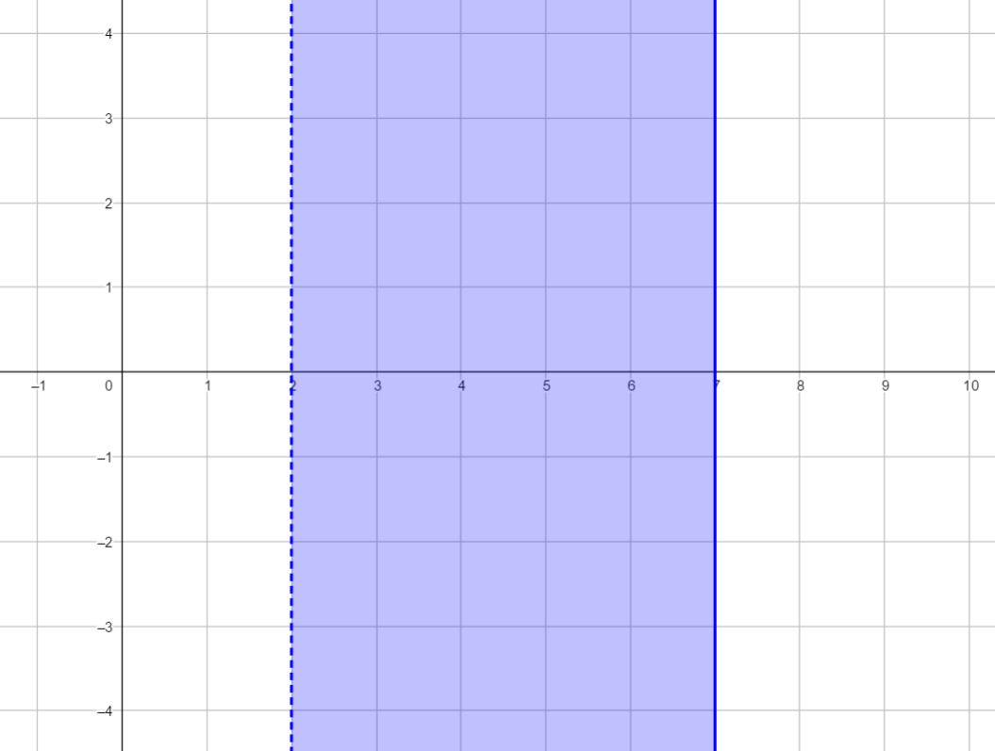
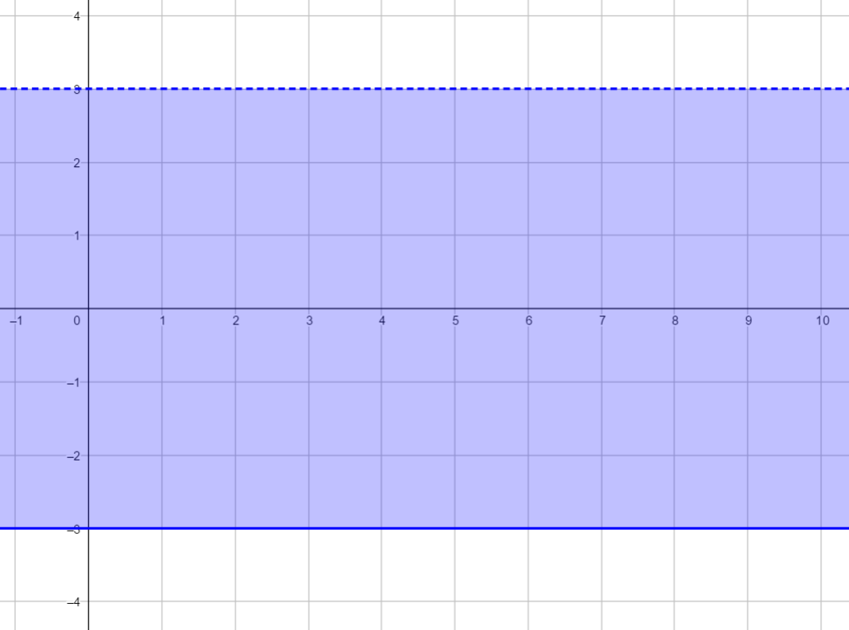
What’s the same and what’s different in these representations?
2
7
-3
3

Slide 3
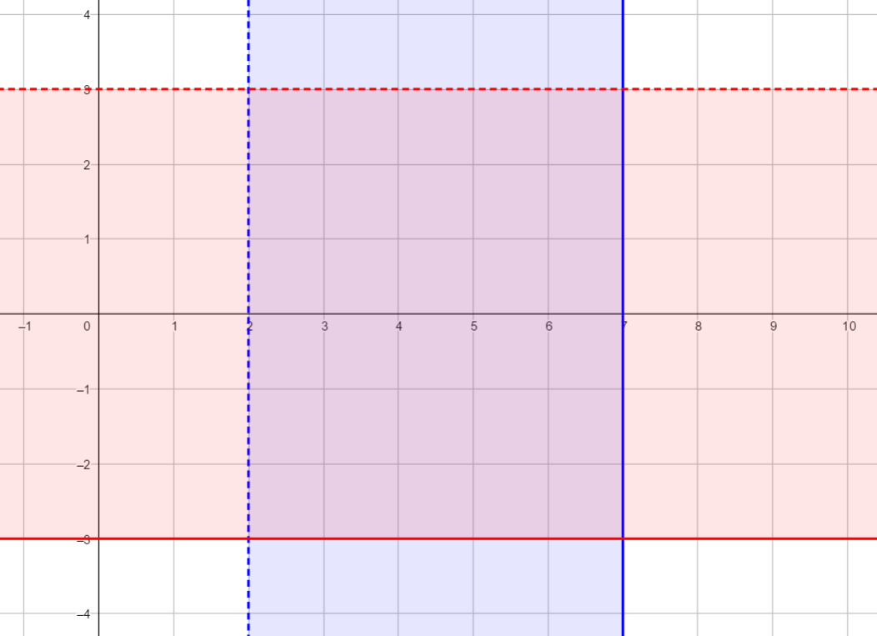
3
7
Notes:
This is the first time meeting a few conventions for inequalities:
The number line notation (filled circles vs empty)
Dotted and filled lines on cartesian plane
e.g.
“This is the notation on a number line, what does a filled dot vs. empty dot mean?”
“This is the notation on the cartesian plane, what does a dotted line mean vs and filled line?”
Then revisit the previous lesson: What (integer coordinates go in the space (the same as last lesson AND (7,2), (3,-3) etc.

Slide 4
Write an inequality that describes the red section of the diagram
Show the inequality on a number line
Notes:
This is the first time meeting a few conventions for inequalities:
The number line notation (filled circles vs empty)
Dotted and filled lines on cartesian plane
e.g.
“This is the notation on a number line, what does a filled dot vs. empty dot mean?”
“This is the notation on the cartesian plane, what does a dotted line mean vs and filled line?”
Then revisit the previous lesson: What (integer coordinates go in the space (the same as last lesson AND (7,2), (3,-3) etc.

Slide 5
Show the following inequalities on a number line
-2 < x ≤ 5
1 ≤ y ≤ 3
5 < x ≤ 8
Write the inequalities these number lines represent
4
10
-4
2

Slide 6
