Slide 1
Are the lifecycles of mammals all the same?
Downloadable Resource
Science - Reproductive Cycles
Miss Hummel

Slide 2
Think task:
Do you know the gestation period of a human baby?
How does this compare to an elephant or mouse?

Slide 3
Match the words
Match the names of the groups of mammals with their definition:
Hatch from eggs. The babies have to hatch out of an egg before they are prepared to continue growing outside of their mothers. Only two mammals actually lay eggs. These include the echidna, or spiny anteater, and the duck-billed platypus.
Placental Mammals
Continue to grow inside their mothers' pouches after they are born. Examples include kangaroos, wallabies, possums, sugar gliders, wombats, Tasmanian devils, and koalas.
Monotremes
Marsupials
Are born prepared to continue their growth outside of their mothers' wombs. Examples include humans, elephants, dogs, and cats.

Slide 4
Answers:
Match the names of the groups of mammals with their definition:
Hatch from eggs. The babies have to hatch out of an egg before they are prepared to continue growing outside of their mothers. Only two mammals actually lay eggs. These include the echidna, or spiny anteater, and the duck-billed platypus.
Placental Mammals
Continue to grow inside their mothers' pouches after they are born. Examples include kangaroos, wallabies, possums, sugar gliders, wombats, Tasmanian devils, and koalas.
Monotremes
Marsupials
Are born prepared to continue their growth outside of their mothers' wombs. Examples include humans, elephants, dogs, and cats.

Slide 5
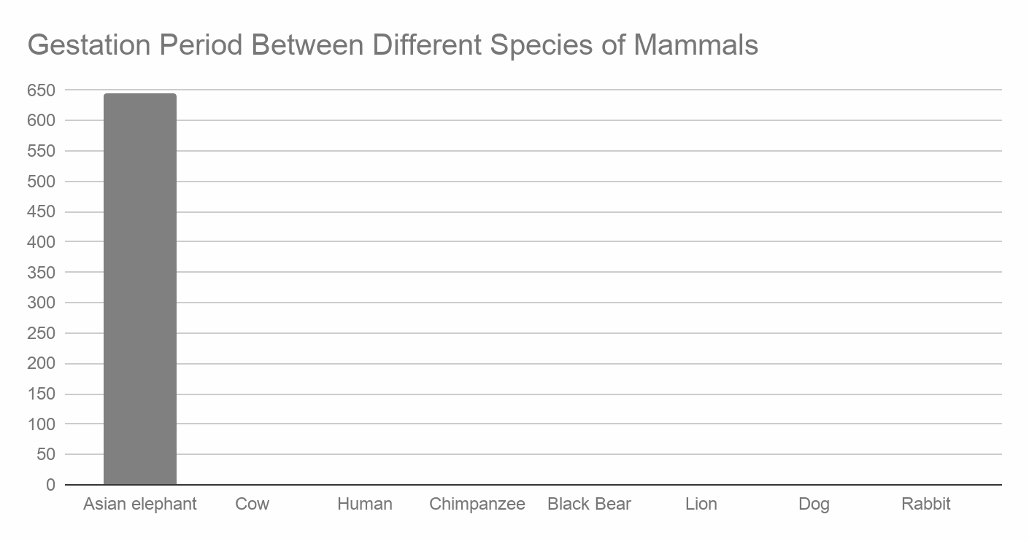
Display and interpret data:
Use the table below to help you draw a bar graph comparing the gestation periods between different species of mammals.
Gestation period
Species | Days
Rabbit | 33
Cow | 284
Asian elephant | 645
Dog | 63
Chimpanzee | 227
Black bear | 210
Lion | 108
Human | 266

Slide 6
Display and interpret data:

Slide 7
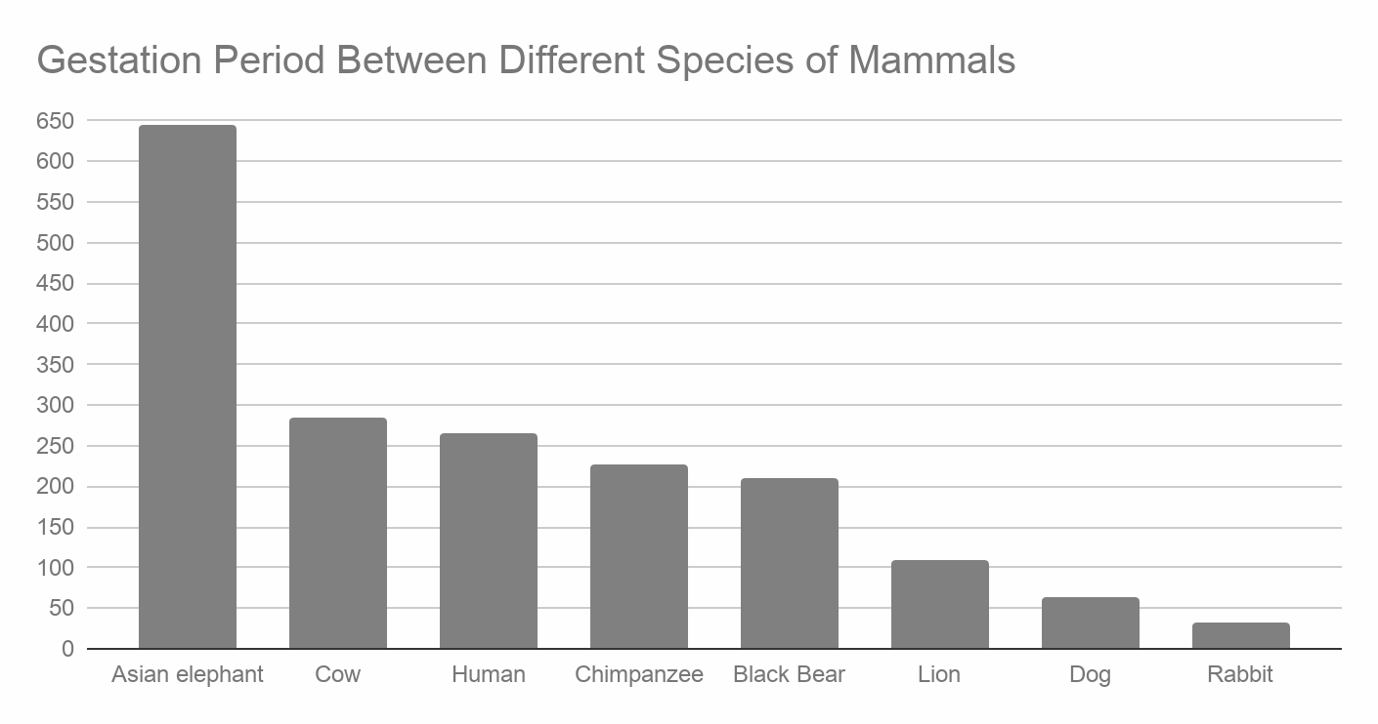
Answers

Slide 8
Can you answer the question:
Is there a relationship between a mammal’s size and its gestation period?

