Slide 1
Decimals and measures:
Convert between standard units of length
Independent Task
Mathematics

Slide 2
Question 1
Complete the table
x10
x100
x1000
34
 | 67
 |  |  | 530

Slide 3
Question 2
Fill in the gaps.
x 1000
x 100
x 10
1 m
100 cm
1000 mm
=
=
÷ 100
÷ 10
÷ 1000

Slide 4
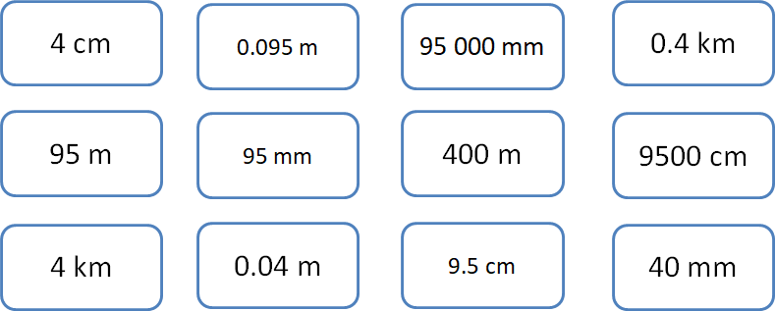
Question 3
Is there an odd one out?
Match the equivalent measures.

Slide 5
Question 4
The distance from Cambridge to Oxford is 135 km.
The distance from Edinburgh to Glasgow is 75 km.
How much further is it from Cambridge to Oxford than Edinburgh to Glasgow?
Give your answer in metres.

Slide 6
Question 5
As part of my training for a 10k race in July, I have been increasing the amount I run each day over the last week.
On Monday, I ran 4.65 km. Each day I added 375 m to that distance.
How far did I run on Sunday in kilometres?

