Slide 1
Comparing numbers
Mathematics
Mrs Bramble and Miss Sidhu

Slide 2
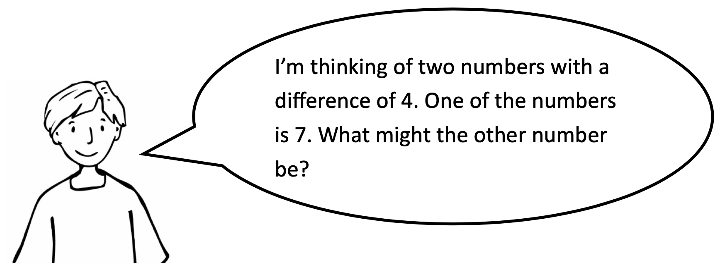
Independent Task

Slide 3
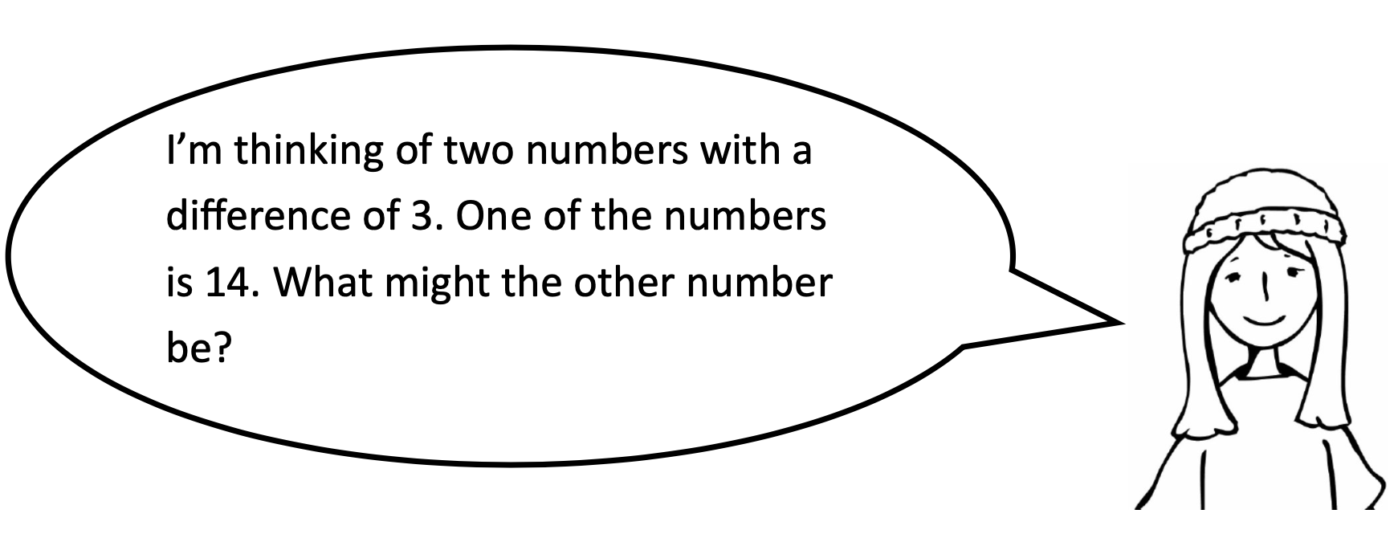
Independent Task

Slide 4
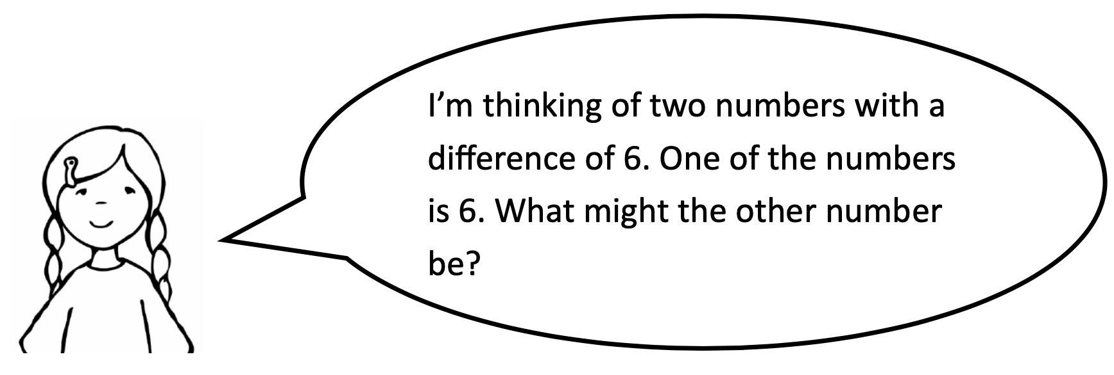
Independent Task

