Slide 1
A Birthday Sensory Story - Activities to extend your child’s learning
Early Development: Celebrations and Festivals - Primary
Katherine Shearer

Slide 2
For this lesson, you will need:
110g Butter
110g Sugar or caster sugar
2 Large eggs
Vanilla extract
110g Self-raising flour
Icing sugar
Paper
Scissors (with adult support/supervision)
Sellotape or glue
Decorations
A cupcake tray / baking tray
12 cupcake cases

Slide 3
Activity 1: Baking cupcakes
For this activity, you will need:
110g Butter
110g Sugar or caster sugar
2 Large eggs
½ tsp vanilla extract
110g Self-raising flour
Icing sugar
A pinch of salt
Water
A cupcake tray / baking tray
12 cupcake cases

Slide 4
Activity 1: Baking cupcakes
What to do in this activity:
Make sure an adult supervises this activity.
Heat the oven to 180ºC/160ºC fan/gas 4 and fill a 12 cupcake tray with cases.
Beat 110g softened butter and 110g golden caster sugar together until pale and fluffy.
Whisk in 2 large eggs.
Add ½ tsp vanilla extract, 110g self-raising flour and a pinch of salt, whisk until just combined then spoon the mixture into the cupcake cases.
Bake for 15 mins.
Leave to cool on a wire rack.

Slide 5
Activity 1: Decorating your cupcakes
What to do in this activity:
Once you have made your cupcakes, have fun decorating them with your learner. Mix icing sugar with water to make icing, then use edibles you have around the house and in the cupboards to decorate the cupcake (smarties, crumbled biscuits, mini marshmallows, grated chocolate, sweets, etc.).
This is a great opportunity to model key vocabulary with your learner, try naming different colours of the sweets, or using the keyword ‘more’.

Slide 6
Activity 2: Making party hats
For this activity, you will need:
Paper or card
Scissors (support your learner to use them safely)
Sellotape or glue
Items to decorate with, e.g.: colouring pens, pencils, paint, crepe paper, glitter, stickers, etc.

Slide 7
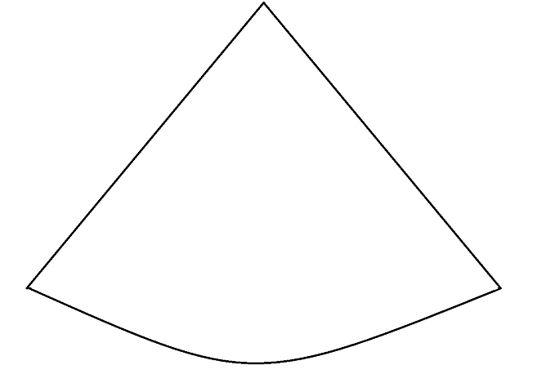
Activity 2: Party hat template
What to do in this activity:
Print out this party hat template or draw your own party hat template on a piece of paper.
Cut the template out carefully with adult supervision or ask an adult to cut it out for you.

Slide 8
Activity 2: Making party hats
What to do in this activity:
With your learner, decorate the party hat template.
This is a great opportunity to encourage your learner to choose between colours, textures and shapes to put on your party hats.

Slide 9
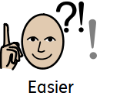
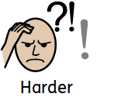
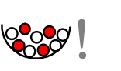
Make it easier
Make it harder
More ideas
Make the cupcake activity more sensory by giving your learner bowls of flour and icing sugar to explore in a messy-play style activity.
Engage your learner by sprinkling flour and allowing them to taste small amounts of icing sugar and decorations where appropriate.
Use keywords during the baking activity, such as ‘more’, ‘less’, ‘sprinkle’ and ‘pour’ to encourage your learner to complete the activity with more independence.
Encourage your learner to express preferences when choosing how to decorate their hats.
You could try:
making your own party poppers or streamers.
holding a party for other members of your family with the items you have made.

Slide 10
References
Party hat template, Katherine Shearer, Oak National Academy.

