Slide 1
Working out missing lengths when given area
Mathematics
Mr Maseko

Slide 2
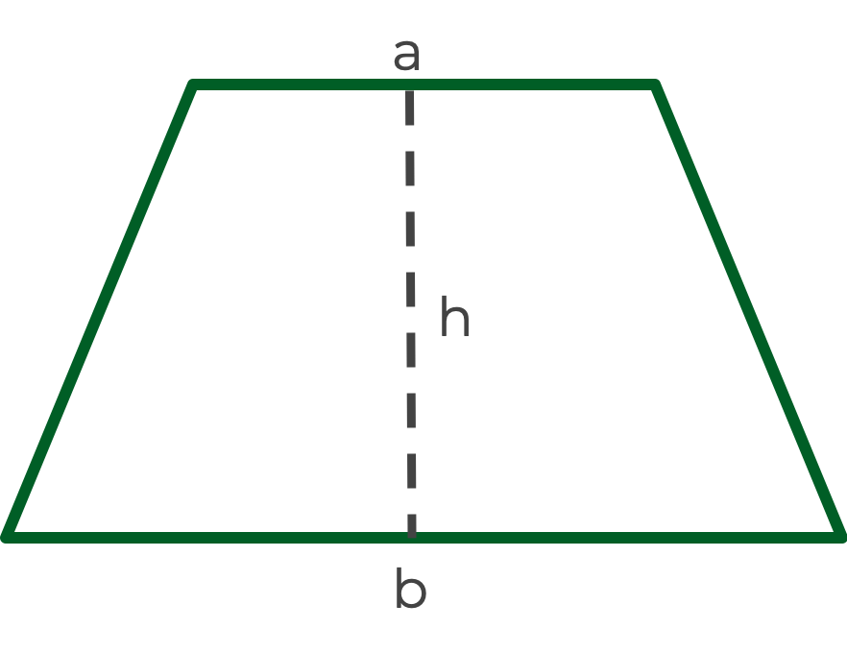
Give possible base and height lengths for a triangle with an area of 24cm²
Give possible a, b and h lengths for a trapezium with an area of 24cm²
Give possible side lengths for a rectangle with an area of 24cm²
What do you notice?

Slide 3
Working out lengths when given area and 1 other length
This rectangle has an area of 18cm² and a base of 6cm.
What is the height of the rectangle?

Slide 4
Working out lengths when given area and 1 other length
This triangle has an area of 18cm² and a base of 4cm.
What is the height of the triangle?

Slide 5
Working out lengths when given area and 1 other length
The area of this trapezium is 30cm².
Given that a = 7cm and b = 5cm, work out h.

Slide 6
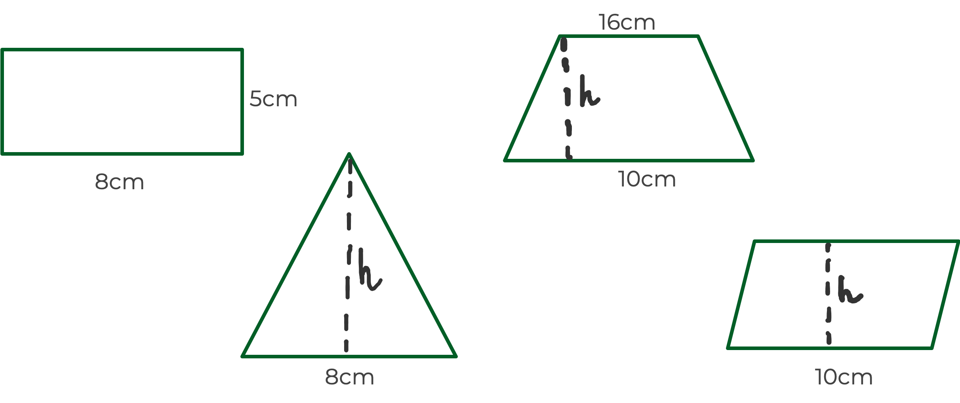
These 4 shapes all have the same area. Work out the heights of the triangle, parallelogram and trapezium.

Slide 7
Draw 4 trapezium with consecutive areas.
What do you notice about the lengths a, b and h?
What will be the lengths of a, b and h in the 20th trapezium of your sequence?

