Slide 1
Equivalent Fractions
Downloadable Resource
Mathematics
Miss Jones

Slide 2
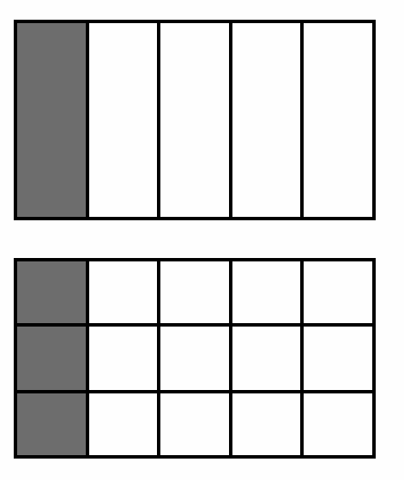
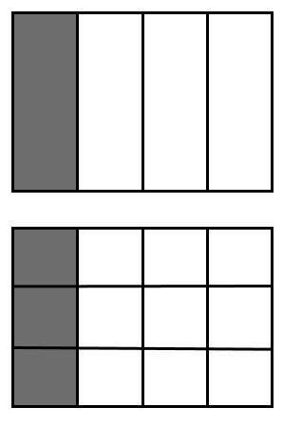
Matching Task
Match the equivalent fractions to the correct representation. Explain how you know and what you notice.
A)
B)
C)
D)

Slide 3
Challenge
Create your own representations for these pairs of equivalent fractions:

