Slide 1
Talk about what people do in general [2/2]
The pronoun ‘on’
Questions using ‘qu’est-ce que’
French
Madame Johnson

Slide 2
[ on ]
non

Slide 3
[ on ]
onze
au fond
[at the back]
monde

Slide 4
l’événement | event
janvier | January
février | February
mars | March
avril | April
mai | May
juin | June
trente | thirty
vingt | twenty
célébrer | to celebrate

Slide 5
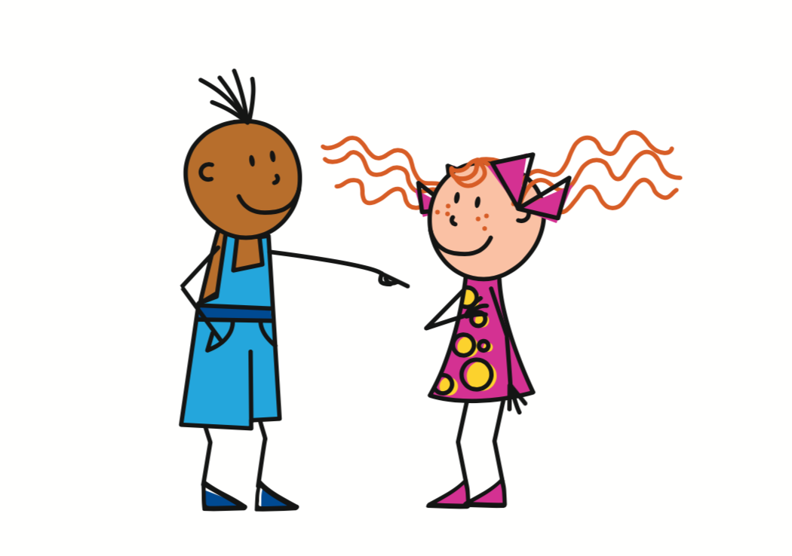
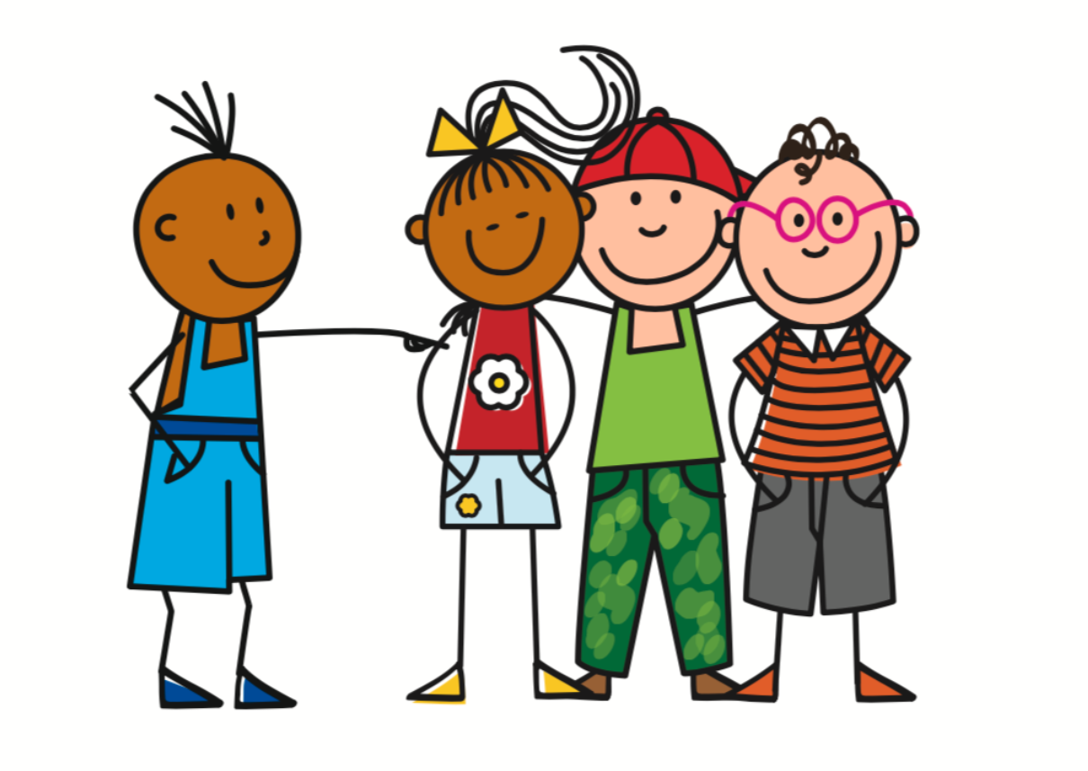
In French, the subject pronoun on is used to talk about what people in general do. We can translate it as ‘people’, ‘you’ or ‘one’.
= You
Tu
On
= You, we
To refer to one specific person
Vous
= You
To refer to a group of specific people
To refer to people in general

Slide 6
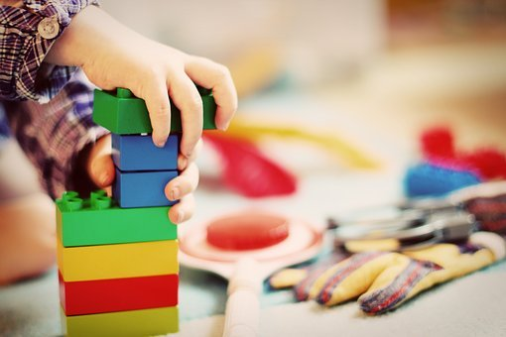
Let’s remember the ‘on’ form of a few well-known verbs from Part 1 of this lesson….
On joue
= You (general) play
jouer
= To play
The third person (pronoun + ending)

Slide 7
Let’s remember the ‘on’ form of a few well-known verbs from Part 1 of this lesson….
Infinitive | ‘On’ form | English
aller | On _ _ | You g...
faire | On _ _ i _ | You d….
vouloir | On _ _ u _ | You w…..
pouvoir | On _ _ _ _ | You c….
devoir | On _ _ _ _ | You m…..
savoir | On _a_ _ | You k…..

Slide 8
Let’s remember the ‘on’ form of a few well-known verbs from Part 1 of this lesson….
Infinitive | ‘On’ form | English
aller | On va | You go
faire | On fait | You do
vouloir | On veut | You want
pouvoir | On peut | You can
devoir | On doit | You must
savoir | On sait | You know

Slide 9
Statement
Elle est malade
She is ill.
Question (intonation)
Elle est malade ?
She is ill?
Please see lesson called ‘distinguishing between having and being 2/2’
Question (inversion)
Est-elle malade ?
Is she ill?
Question (est-ce que)
Is she ill?
Est-ce qu’elle est malade ?

Slide 10
Que? = What?
Question
(Inversion)
Que fais-tu?
What are you doing?
Question
(est-ce que)
Qu’est-ce que tu fais?
Que
est-ce que
pronoun
verb
= qu’est-ce que

Slide 11
Que
est-ce que
pronoun
verb
Qu’
est-ce que
tu
aimes?
What do you like?
Qu’
est-ce qu’
il
mange?
What does he eat?

Slide 12
Talk about what people do in general [2/2]
Translate the sentences:
Qu’est-ce qu’on fait? =
What is she playing? =
What do you (specific) want? =
What do you (general) do? What are you (general) doing?
Qu’est-ce qu’elle joue?
Qu’est-ce que tu veux?

