Slide 1
Building More Sentences
Lesson 11 of 14 on Using Language
Speech and Language Therapy
Emma Jones

Slide 2
Colourful Semantics
Colourful Semantics is a programme that was developed by a Speech and Language Therapist named Alison Bryan.
It is a colour coded approach to show how a sentence is made up.

Slide 3
Where?
What?
Green - Objects/Nouns
Can include:
Things e.g. banana, house, sweets, toilet
People e.g. boy, old lady
Animals e.g. cat, emu
Occupations e.g. vet, brave soldier
Pronouns e.g. him, her, it, them
(Include added adjectives/ describing words e.g. big man, brown horse, sad girl)
Blue - Positions/locations
Can include:
Location e.g. at, on, in, under, in front of, behind, beside, next to, between, above, below, through, over, among, with, beneath, out of, off, across
Places e.g. garden, chair, classroom, beach, bridge

Slide 4
Encourage sentences!
Model ‘Who?’, ‘What doing?’, ‘What?’ and ‘Where?’ when reading books and looking at pictures.
Point to images and label ‘Who’, ‘What doing’, ‘What?’ and ‘Where?’ e.g. ‘Look, caterpillar eating an apple!’ or ‘The boy is eating his sandwich in the park’.
Expand your child’s language by using their words in a short sentence. E.g. if the child says “daddy driving” in the car, you can turn that into a simple sentence sentence like “Daddy is driving the car on the road!”.
Build the language into your everyday situations and playtime by commenting and labeling who is doing what in play
Notes:
By identifying toys, foods, and activities the child enjoys, you will be able to think of labels and comments for words associated with these things. For example, if the child enjoys swimming, you could repeat verbs like “pour”, “wash”, or “splash” when he has a bath. If the child likes to play with cars, you could use verbs like “push”, “crash”, or “go” when you play cars together.
Children need to hear new words many times before they start to use them themselves. When interacting with the child, try to use a new word several times during the activity. Then use it again the next time you do that same activity. And then use it again when you do a different activity with your child.

Slide 5
Make it visual!
Use what you made in lesson 10 and then add symbols and sentence strips for ‘What?’ and ‘Where?’
You will need:
Coloured paper/pencils- Green and Blue
Scissors
Paper
Writing equipment
‘How to make symbols and sentence strips’ sheet
Making a sentence strips for ‘Who?’ ‘What doing?’ ‘What?’ and ‘Where?’
Take 1 plain sheet of a4 paper and turn it landscape
Draw 5 boxes on the piece of paper so it looks like example
Either colour the 4 smaller boxes at the bottom in so they look like this, or cut out and stick down pieces of coloured paper

Slide 6
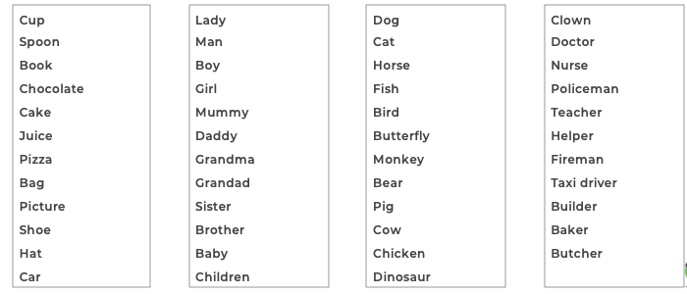
Nouns you might want to include for ‘What?’!
Objects
People
Animals
Occupations

Slide 7
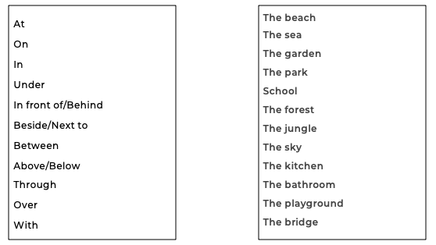
Prepositions and Locations you might want to include!
Prepositions
Places

Slide 8
Give time! Have you given them enough time to formulate an answer? WAIT 10 seconds!!
Give a sentence starter e.g. “The girl is…...”
Give a clue e.g. related to the picture or a sound clue “It begins with rrrrrr...”
Give a choice e.g. “Is she running or eating?”
Model and comment on what you see e.g. “Ah, I think she is eating”

Slide 9
Using Language Diary
Insert picture
Date:
We learnt about _______________________________________________
When my adult __________________________________________________________________________________________________________
I…
__________________________________________________________________________________________________________

