Slide 1
Addition and Subtraction within 10
Using manipulatives to count on when adding
Mathematics
Independent Task
Mrs Khaira

Slide 2
Activity 1

Slide 3
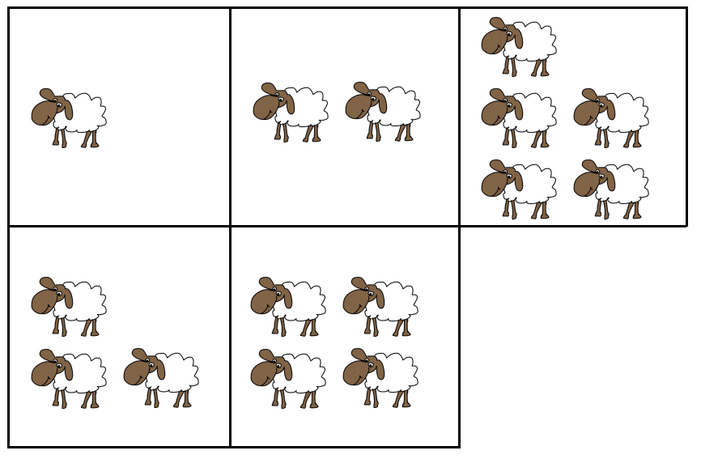
Activity 2

