Slide 1
Rate of Reaction Required Practical 1
Worksheet
Combined Science - Chemistry - Key Stage 4
The Rate and Extent of Chemical Change
Dr Deng

Slide 2
Independent practice

Slide 3
Task
The table shows results that were obtained from a reaction between magnesium and different concentrations of hydrochloric acid. Hydrogen gas was collected using a gas syringe and the time taken to collect 50cm³ of gas was recorded.
State the independent and dependent variable.
Plot a graph using the data from the table. Draw a line of best fit.
Describe the relationship between concentration of hydrochloric acid and time taken to collect 50cm³ of hydrogen gas.
Explain how the concentration of hydrochloric acid affects rate of reaction with magnesium.
Concentration of HCl (M) | Time taken to collect 50cm³ hydrogen gas (s)
0.5 | 170
1.0 | 90
1.5 | 56
2.0 | 34
2.5 | 28
Table of results

Slide 4
Graph paper

Slide 6
Answer
Independent variable: Concentration of hydrochloric acid (M)
Dependent variable: Time taken to collect 50cm³ hydrogen gas (s)

Slide 7
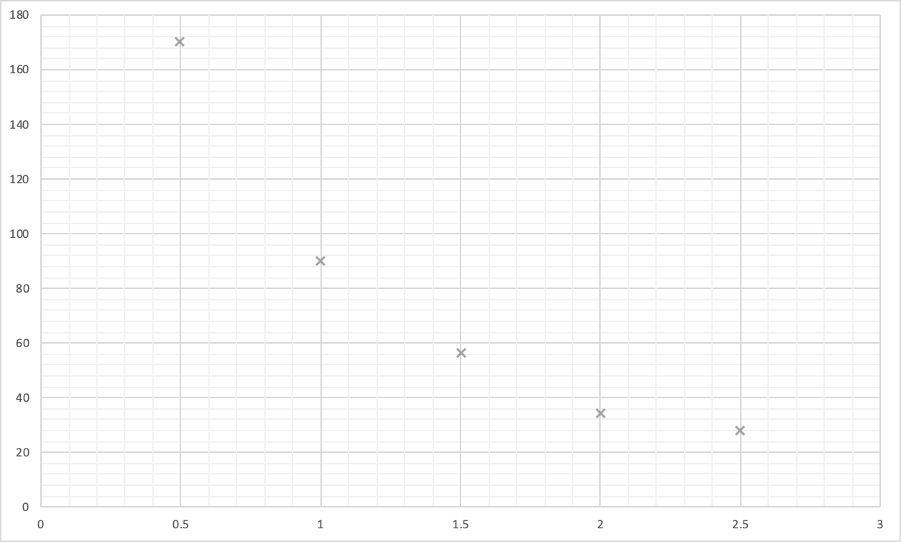
Answer
2) Plot a graph using the data from the table. Draw a line of best fit.
Success criteria:
Scale
Axis title + units
Correct data points
Line of best fit (smooth curve)
Time taken to collect 50cm³ hydrogen gas (s)
Concentration of hydrochloric acid (M)

Slide 8
Answer
3) Describe the relationship between concentration of hydrochloric acid and time taken to collect 50cm³ of hydrogen gas.
As the concentration of hydrochloric acid increases, the time taken to collect 50cm³ of hydrogen gas decreases.
4) Explain how the concentration of hydrochloric acid affects rate of reaction with magnesium.
Increasing the concentration of hydrochloric acid increases the rate of reaction. There are more number of reacting particles per unit volume, therefore particles collide more frequently.

Slide 9
Writing a method to find rate of reaction
Magnesium + Hydrochloric acid → Magnesium Chloride + Hydrogen
rubber connector
Source: Oak

Slide 10
Magnesium + Hydrochloric acid → Magnesium Chloride + Hydrogen
Hypothesis: Increasing the concentration of hydrochloric acid increases the rate of reaction.
Task 1 - Identify the following
Independent variable:
Dependent variable:
Two control variables:
rubber connector
Source: Oak

Slide 11
Hypothesis: Increasing the concentration of hydrochloric acid increases the rate of reaction.
Task 2 - Write a method for an investigation to show how the concentration of hydrochloric acid affects the rate of the reaction with magnesium

Slide 12
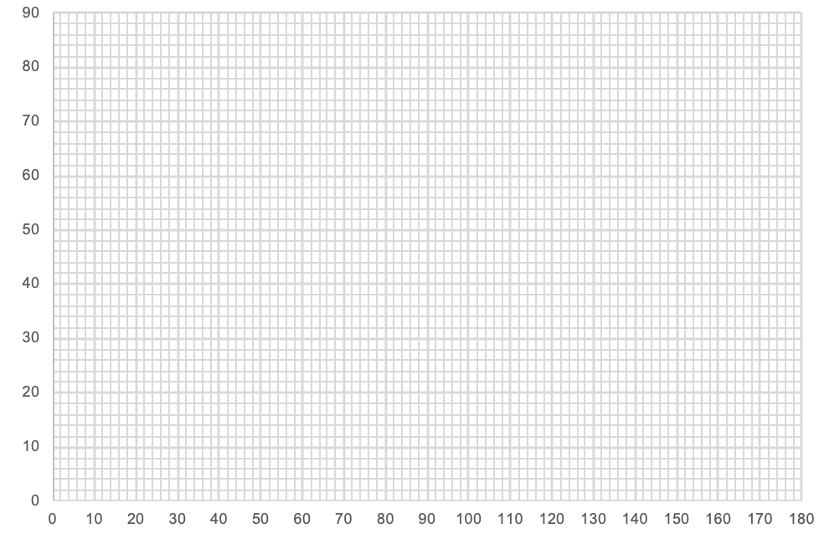
Task 3 - Plot a graph from the table of results given and draw line of best fit
Time (s) | Volume of hydrogen (cm³)
0 | 0
20 | 22
40 | 40
60 | 54
80 | 65
100 | 70
120 | 72
140 | 74
160 | 74
180 | 74
Volume of hydrogen (cm³)
Time (seconds)
Notes:
Animate the process of plotting data from table

Slide 13
Task 4
Describe the two ways gas can be collected from a chemical reaction to calculate rate of reaction.
In terms of collision theory, explain why increasing the concentration of hydrochloric acid increases the rate of reaction.

Slide 14
Answer
Task 1
Independent variable: Concentration of hydrochloric acid (M)
Dependent variable: Volume of hydrogen gas (cm³)
Control variables: Volume of hydrochloric acid
Mass of magnesium
Temperature

Slide 15
Answer
Task 2
Measure 20 cm³ of 0.5 M hydrochloric acid using a measuring cylinder, then pour the acid into a conical flask.
Place two 2 cm magnesium strips into the conical flask. Insert a rubber bung into the conical flask and attach it to a delivery tube that is connected to a gas syringe.
Measure the volume of gas in the syringe every 20 seconds for 3 minutes.
Record the results in a table.
Repeat 3 times and find a mean.
Repeat procedure using 1.0 M and 1.5 M of hydrochloric acid.

Slide 16
Task 3 answer
Time (s) | Volume of hydrogen (cm³)
0 | 0
20 | 22
40 | 40
60 | 54
80 | 65
100 | 70
120 | 72
140 | 74
160 | 74
180 | 74
x
x
x
x
x
x
x
Volume of hydrogen (cm³)
x
x
x
Time (seconds)
Notes:
Animate the process of plotting data from table

Slide 17
Task 4 answer
Describe the two ways gas can be collected from a chemical reaction to calculate rate of reaction.
Using a gas syringe
Using an inverted measuring cylinder in a trough of water
In terms of collision theory, explain why increasing the concentration of hydrochloric acid increases the rate of reaction.
The higher the concentration of hydrochloric acid, the more particles per unit volume. Particles collide more frequently, rate of reaction increases.

