Slide 1
Solving problems involving subtraction and addition with unknown values
Independent Task
Mathematics
Miss Brinkworth

Slide 2
Part A - Follow our SC to answer these
Josh played two rounds of laserblast but couldn’t remember his score in the first round. He score 425 in the second round and 867 in total. What was his first round score?
Mo and Kelsey are playing monopoly and Mo landed on one of Kelsey’s hotels. He had to pay her £450 which meant he only had £263 left. How much did Mo have before he landed on the hotel?
There were 200 fewer fireworks accidents in Leicestershire this year compared to last year. If there were 497 this year, how many accidents were there last year?

Slide 3
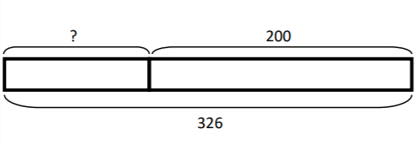
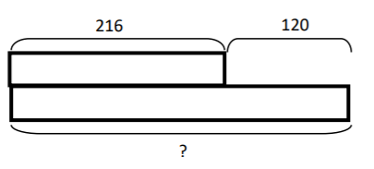
Part B
Decide which of these bar models might show a subtraction and an addition
Beka mixed 275 ml of red paint with a tin of white paint to make 633 ml of pink paint. What mistake have I made with this bar model for this question?
275
633
?

