Slide 1
Multiplying and Dividing in Standard Form
Mathematics
Miss Oreyomi
Miss Oreyomi

Slide 2
Your turn
Give your answer in standard form
Notes:
Talk about standard form and the way it must be written

Slide 3
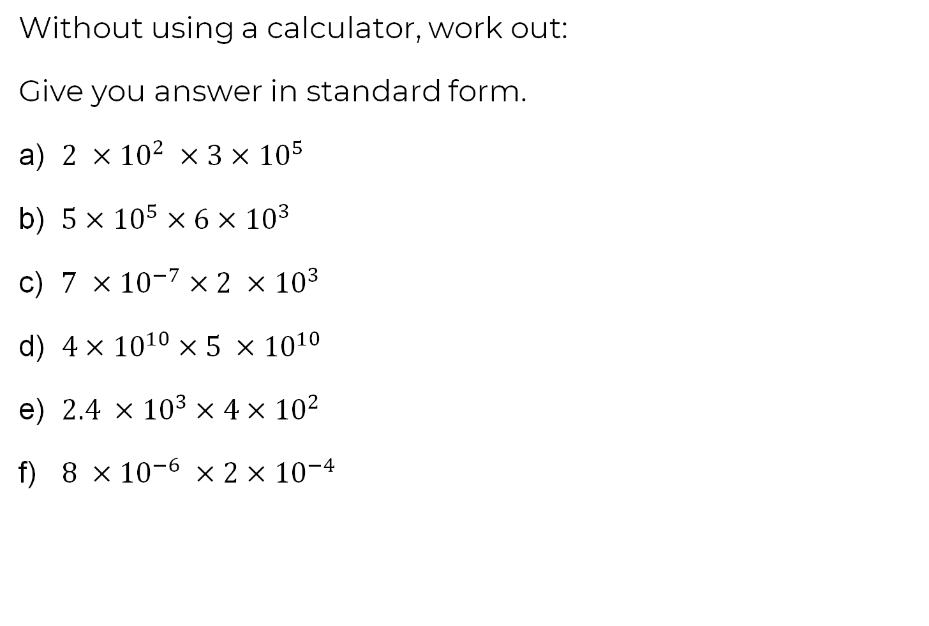
Questions

Slide 4
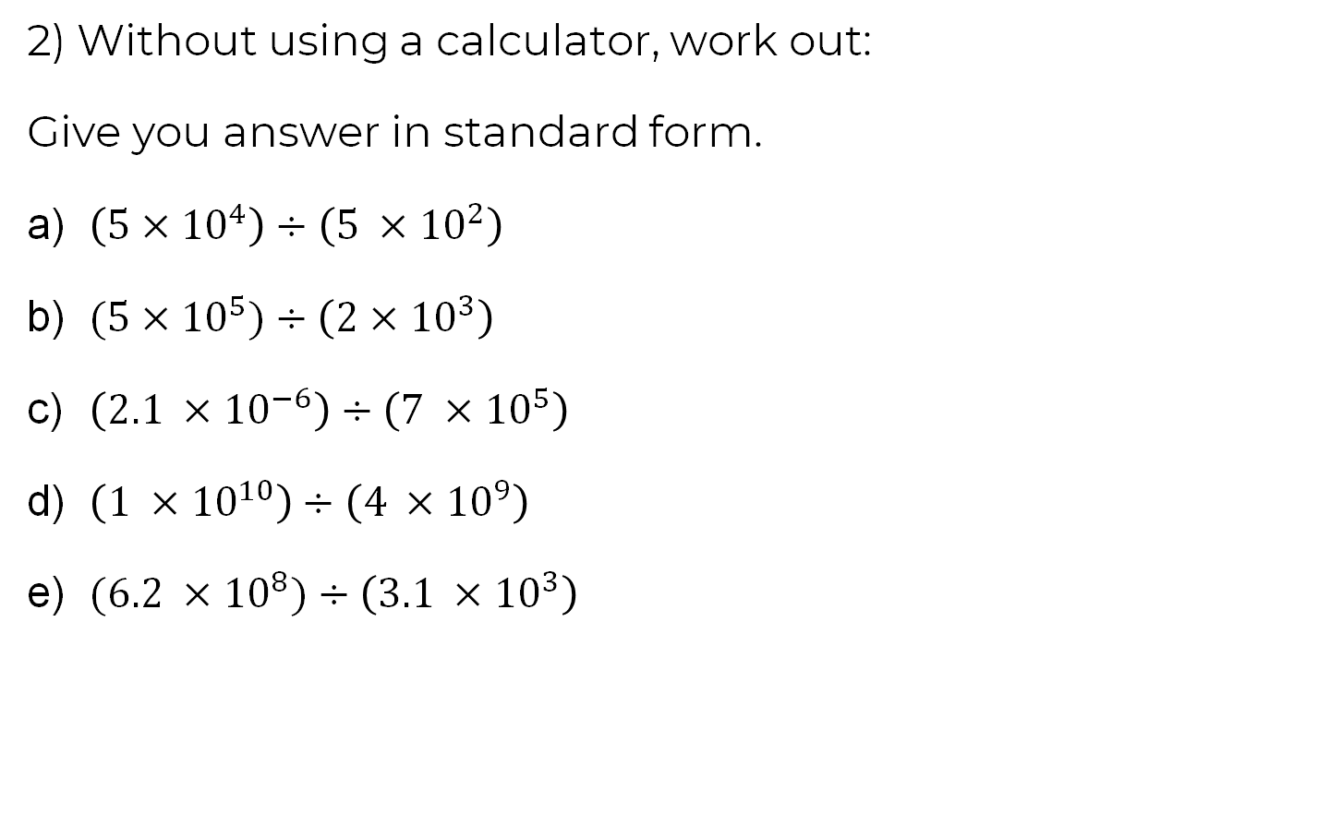
Questions

Slide 5
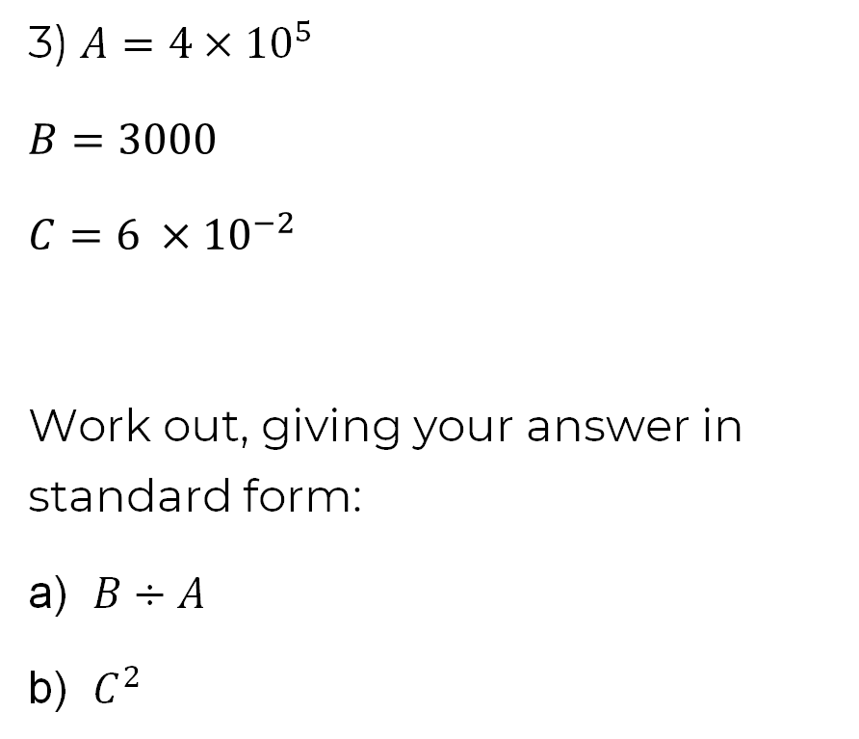
Questions

