Slide 1
3-D Shape: Consolidating 3-D shape learning
Mathematics
Ms Jeremy

Slide 2
3-D shape vocabulary
Face
Edge
Vertex
Vertices
Apex
A corner where edges meet.
A flat or curved surface on a 3-D shape.
Corners where edges meet.
The area where 2 faces meet.
The vertex at the top of the shape.

Slide 3
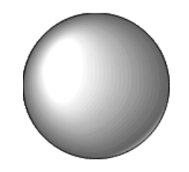
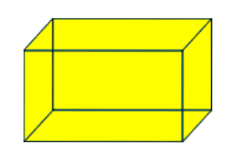
Pause the video to complete your task
Resume once you’re finished
Can you use the vocabulary to label these shapes?
‘This shape is called a ______________ and has ______ faces, _____ edges and ______ vertices.’

Slide 4
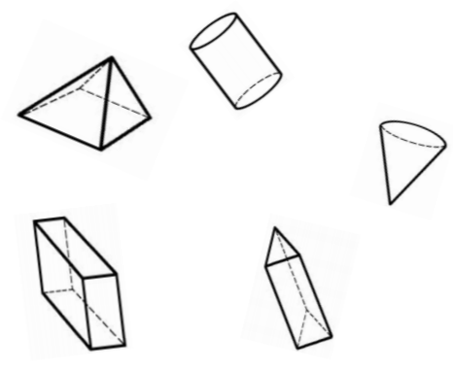
Pause the video to complete your task
Resume once you’re finished
The following shapes are divided into 2 groups according to their properties: what could the groups be?
E.g. ‘Has flat surfaces’, ‘Has curved surfaces’.

Slide 5
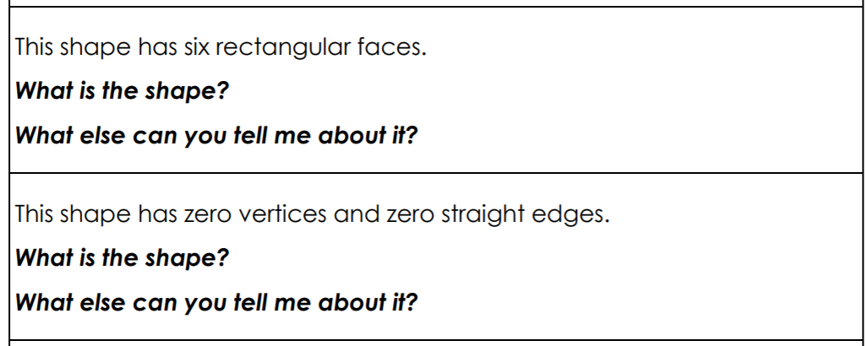
Application of 3-D shape learning

Slide 6
Pause the video to complete your task
Resume once you’re finished
I have some shapes in a bag. In total, there are 12 faces and 12 vertices. What could my shapes be?

Slide 7
Independent Task
Pause the video to complete your task
Complete the table using items that you can find in your house.
Resume once you’re finished
Shape | Items | Properties
Cuboid
Triangular prism
Cone
Cylinder

