Slide 1
Reactivity
Lesson 2 - Ions
Chemistry - Key Stage 3
Miss Fenner

Slide 2
Pause the video to complete your task
Why are the group 0 elements unreactive?
Their outer shell…
So they are…
Resume once you’re finished

Slide 3
Pause the video to complete your task
Why are the group 0 elements unreactive?
Their outer shell is full of electrons.
So they are stable.
Resume once you’re finished

Slide 4
Independent Practice
A magnesium atom loses 2 electrons. State the charge of the ion it forms.
Explain how sodium forms an ion with a charge of +1.
Draw the ion that forms when fluorine reacts.

Slide 5
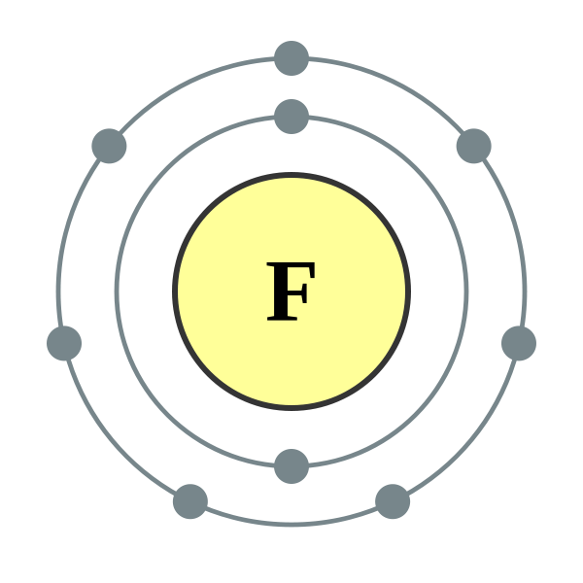
Independent Practice
The magnesium ion will have a charge of 2+.
When sodium reacts it loses 1 electron to have a full outer shell. So it has one extra positive proton than negative electron and has an overall charge of +1.
-

Slide 6
Pause the video to complete your task
How does a chemical bond form in sodium chloride?
Sodium atoms ____ an electron to form a sodium ion with a charge of _____.
Chlorine atoms ____ an electron to form a chloride ion with a charge of _____.
There is an attraction between...
Resume once you’re finished

Slide 7
Pause the video to complete your task
How does a chemical bond form in sodium chloride?
Sodium atoms lose 1 electron to form a sodium ion with a charge of +1.
Chlorine atoms gain 1 electron to form a chloride ion with a charge of -1.
There is an attraction between Na+ and Cl- which creates the chemical bond.
Resume once you’re finished

