Slide 1
Independent Task
To investigate number patterns
Maths
Mr Critchlow

Slide 2
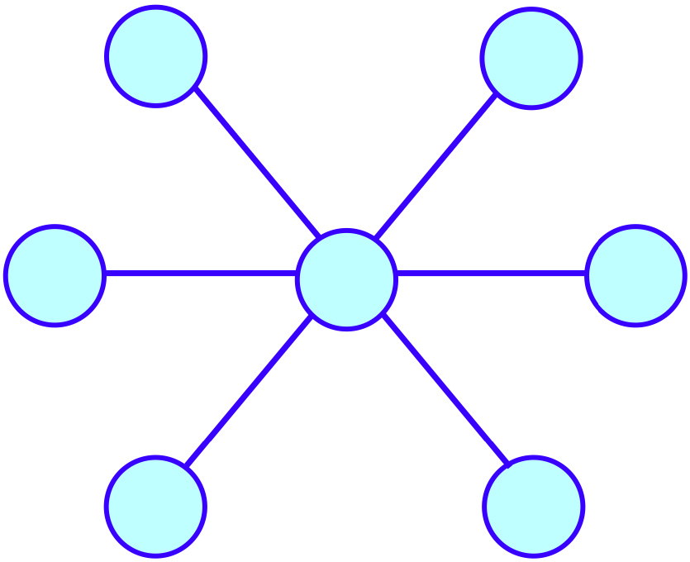
To Start
Can you fit the numbers:
1, 2, 3, 4, 5, 6 and 7 into the circles so that each 3 circles joined by lines have the same total?

Slide 3
Moving On
What is the rule for each of the sequences? It could be add, subtract, multiply or divide.
Term 1 | Term 2 | Term 3 | Term 4 | Term 5 | Rule
3 | 6 | 12 | 24 | 48
640 | 320 | 160 | 80 | 40
0.4 | 0.8 | 1.6 | 3.2 | 6.4
20 | 10 | 0 | -10 | -20
3770 | 4270 | 4770 | 5270 | 5770

Slide 4
Main Task
You will be creating and exploring your own number sequences.
Choose a STARTING NUMBER (Eg: 7).
Decide which OPERATION to do first [+, -, x or ÷] (eg x).
Decide what NUMBER to use with the operation you picked in step 2 (Eg 3).
Decide on a different OPERATION (Eg -).
Decide what NUMBER to use with this operation (Eg 3).
Repeat with your last answer as the new starting numbers.
RECORD THE FIRST 10 TERMS IN YOUR SEQUENCE.
(7 x 3) - 3 = 18
(18 x 3) - 3 = 51
(51 x 3) - 3 = 150

Slide 5
Main Task
Write out the sequence and then make as many statements as you can about the numbers in the sequence.
Term 1
Term 2
Term 3
Term 4
Term 5
Term 6
Term 7
Term 8
Term 9
Term 10
What I notice about my sequence.

Slide 6
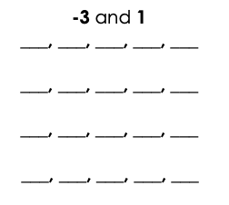
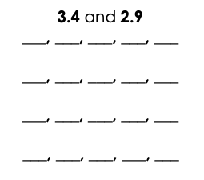
Challenge
Can you write 4 of your own sequences containing these numbers?

