Slide 1
Finding half of a number within 10
Mathematics Independent Task
Miss Robson

Slide 2
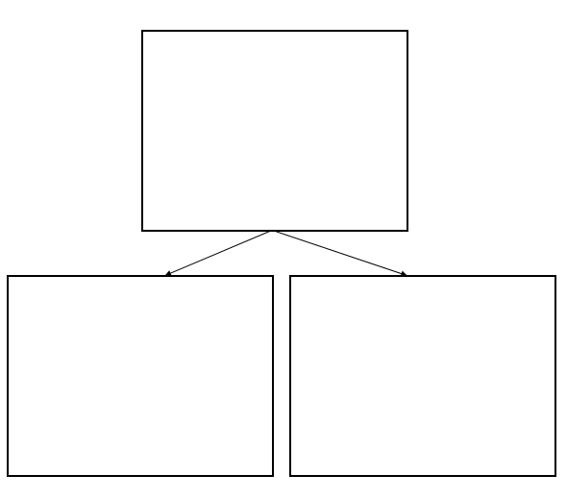
Activity
Find half of numbers to 10, and sort them into numbers that can be halved, and numbers that cannot.
Can share | Cannot share

