Slide 1
Plants and Photosynthesis
Lesson 7- Review Lesson 1
Biology - Key Stage 3
Miss White

Slide 2
Fact Sheet 1- Plant Key Facts
Cellulose - Plant cell walls are made of tough cellulose which support the cell and allow it to keep its shape
Cell Wall - Plant cell organelle which is made of cellulose and keeps the cell firm
Starch - A polymer carbohydrate that is made by joining together glucose monomers
Stomata - Tiny pores in the underside of the leaf, which when open, allow gases into and out of the leaf. Singular is stoma
Vacuole - Plant cell organelle which stores cell sap
Notes:
Here are 3 key fact sheets. These can be found in your DLD

Slide 3
Fact Sheet 2- Transport Key Facts
Active Transport - Process by which roots absorb minerals from the soil using energy from respiration
Osmosis - The diffusion of water from an area of high water concentration to an area of low water concentration
Phloem - Plant tissue that carries dissolved sugars from the leaf around the plant
Transpiration - The flow of water into the root, up the stem and out of the leaves
Xylem - A long, thick-walled tube found in plants, formed from many dead cells. This tissue carries water and dissolved mineral salts through the plant

Slide 4
Fact Sheet 3- Photosynthesis Key Facts
Chloroplast - A green disc found in plant cells where photosynthesis takes place to produce glucose and oxygen
Chlorophyll - The green pigment inside chloroplasts that absorbs the energy transferred from the sun by radiation for photosynthesis
Glucose - The sugar produced by photosynthesis and needed for respiration
Photosynthesis - A series of reactions carried out by the green part of plants. Carbon dioxide and water combine to form glucose and oxygen. This process requires energy transferred by light

Slide 5
Here is a diagram of a root hair cell
Cell wall
Nucleus
Cell membrane
Vacuole
Cytoplasm
Label the diagram using the key words
Source Miss White

Slide 6
Plant Roots Key Questions
Name the organelle which is normally found in plant cells which is not found in root hair cells
Explain why this organelle is not found in root hair cells
Name two substances that are taken up by the roots
Describe and explain two ways the root hair cell is well adapted for its job

Slide 7
Answer box
________________________________________________________________________________________________________________________________________________________________________________________________________________________________________________________________________________________________________________________________________________________________________________________________________________________________________________________________________________________________________________________________________________________________________________

Slide 8
Look at the table. Explain why root hair cells cannot absorb minerals by diffusion
Name the process by which mineral ions are absorbed
Mineral | Concentration in the cell (ppm) | Concentration in the soil (ppm)
Potassium | 4 | 0.2
Nitrate | 25 | 0.7
Phosphorus | 5 | 0.1

Slide 9
Answer box
________________________________________________________________________________________________________________________________________________________________________________________________________________________________________________________________________________________________________________________________________________________________________________________________________________________________________________________________________________________________________________________________________________________________________________

Slide 10
Rate of photosynthesis
Identify the independent variable
Identify the dependent variable
Describe the graph
Explain the graph
Rate of photosynthesis
Carbon dioxide concentration
Source Miss White

Slide 11
Uses of Glucose Key Questions
Name 3 chemicals which glucose can used to produce
Which reaction requires glucose as one of the reactants?
In which organelle does this reaction take place?
What does this reaction release?
Why is this important in the roots?

Slide 12
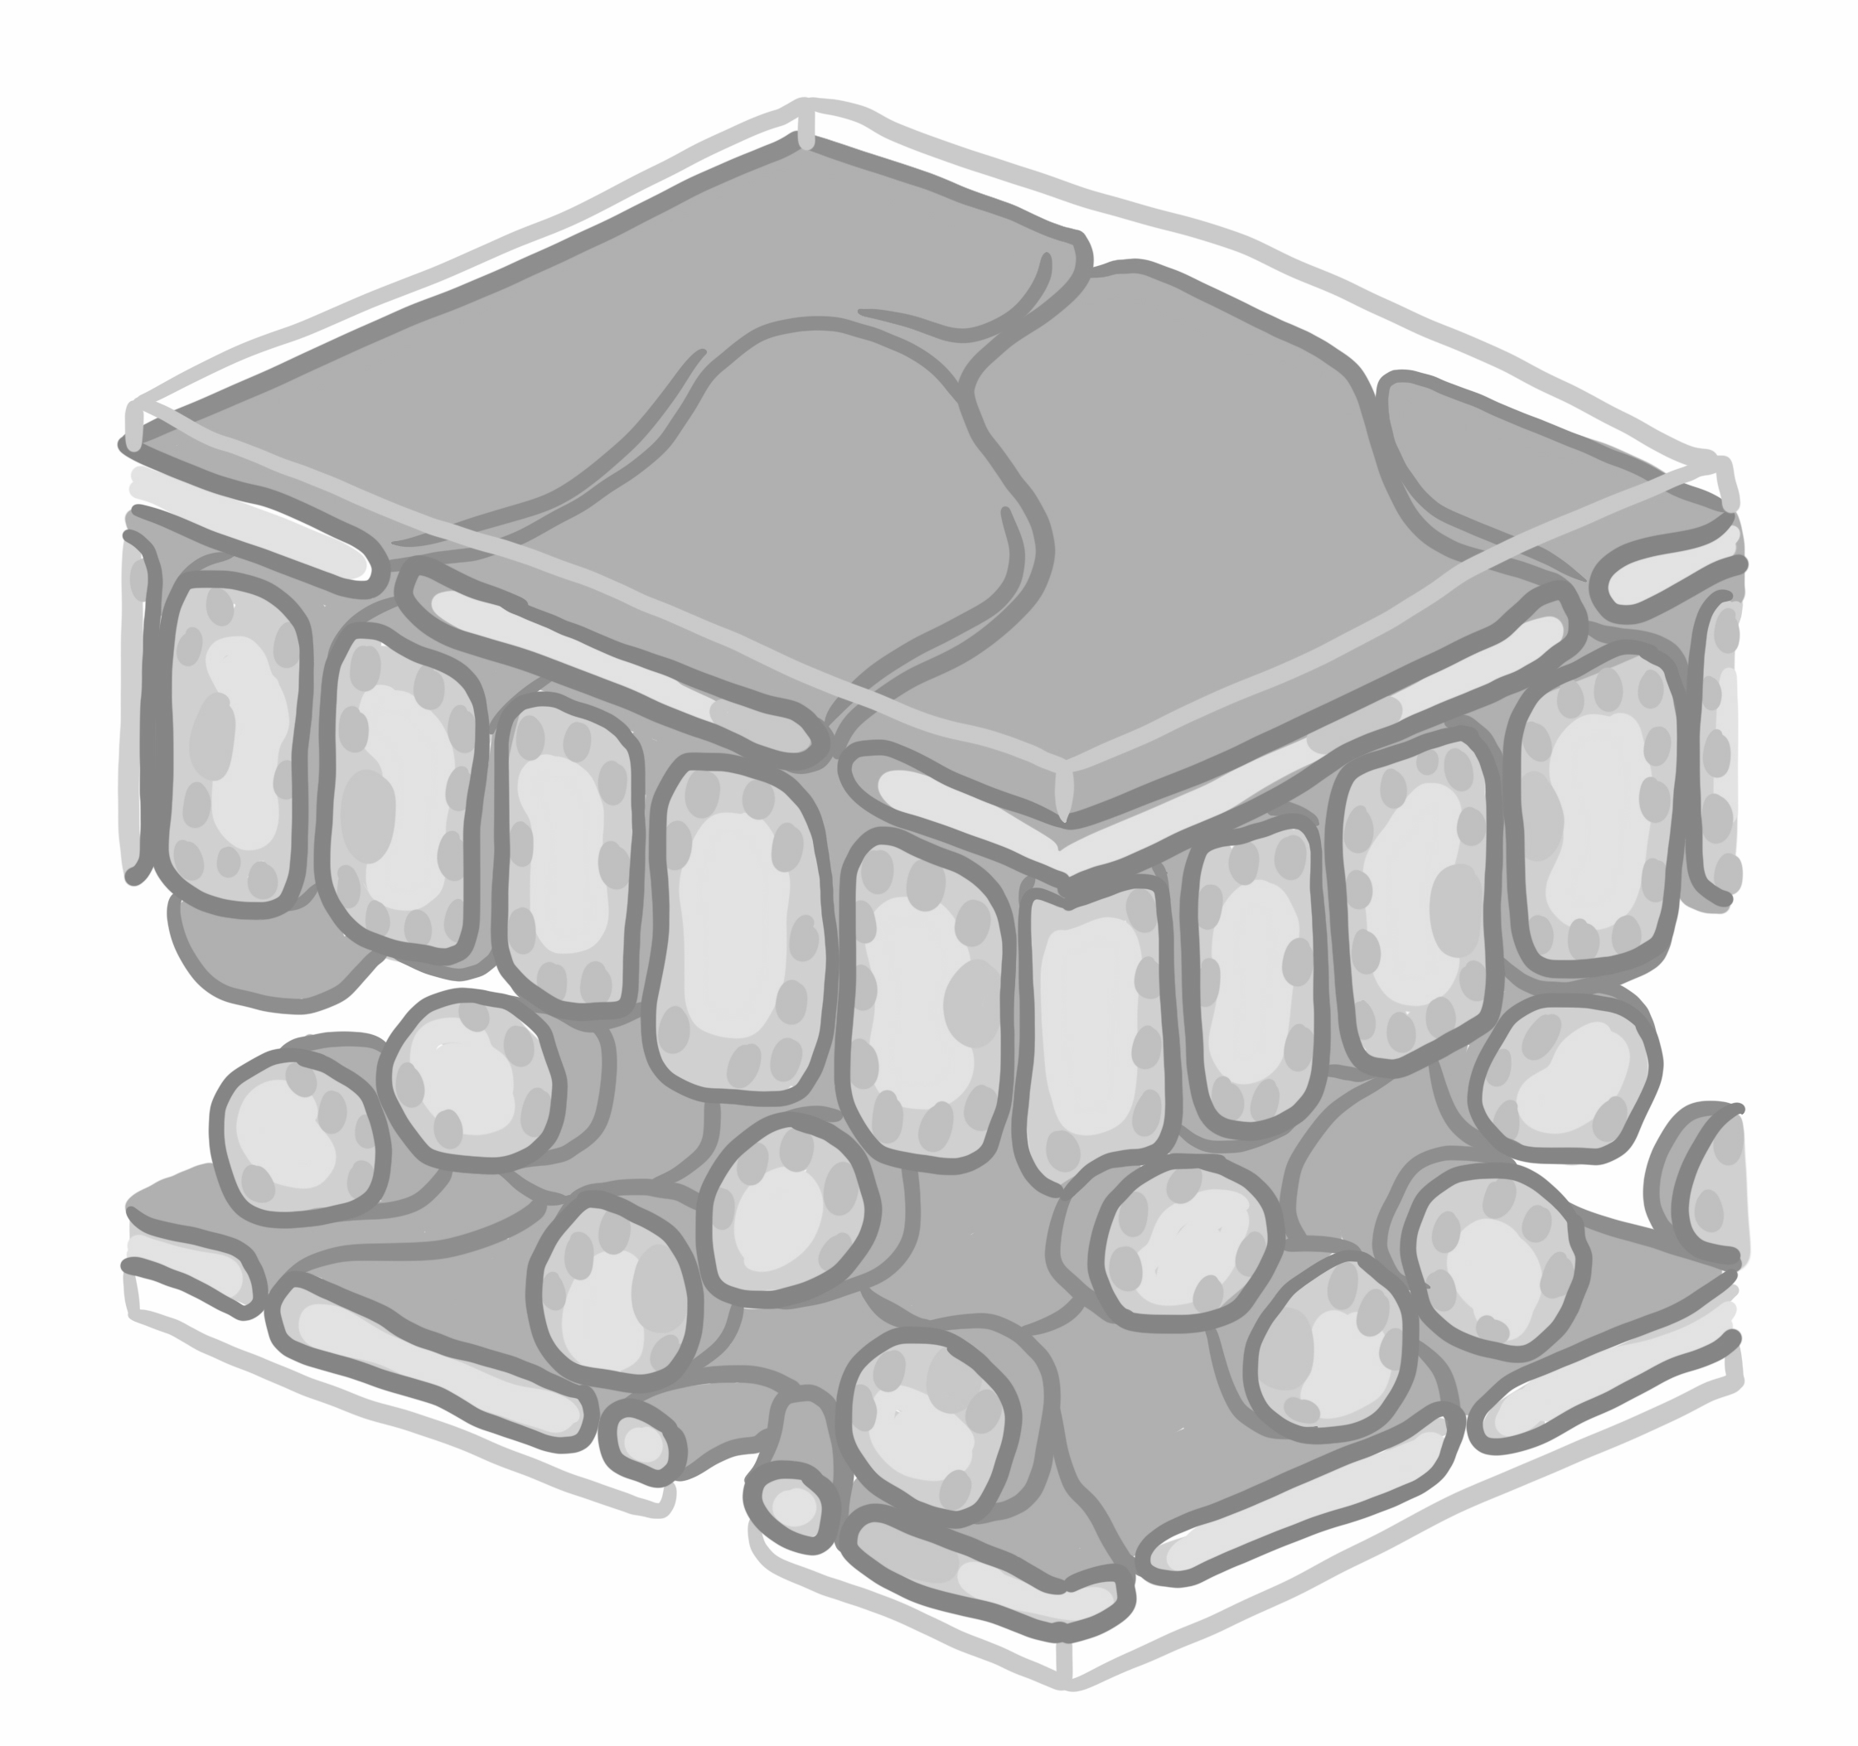
_______
_______
_______
_______
_______
Source: Oak

Slide 13
Match the part to the description
Spongy Mesophyll |  | Waterproofs the leaf
Upper Epidermis |  | Holes on the underside of the leaf
Waxy Cuticle |  | Upper layer of the leaf
Palisade Cell |  | Randomly spaced to allow for diffusion of gases
Stoma |  | Site of photosynthesis

Slide 14
Leaves Key Questions
Here are three adaptations of leaves.
Explain how these features make the leaf well adapted for its job
Leaves are wide and flat
The palisade cells contains lots of chloroplasts
Leaves have veins
Extension:
Explain why having very few stomata on the top of the leaf is an advantage to the plant

Slide 15
Answer box
________________________________________________________________________________________________________________________________________________________________________________________________________________________________________________________________________________________________________________________________________________________________________________________________________________________________________________________________________________________________________________________________________________________________________________

