Slide 1
Lesson 1: The Cost of Cybercrime
KS4 Security
Computing
Ben Garside
Materials from the Teach Computing Curriculum created by the National Centre for Computing Education

Slide 2
Task 1 - The problem that affects the whole world
Visit the link below to see the LIVE CYBER THREAT MAP, which gives a live representation of the number of attacks being detected at any moment.
oaknat.uk/comp-threatmap
Which country is initiating the most attacks?
Which countries are the targets?
What type of attacks are being launched?

Slide 3
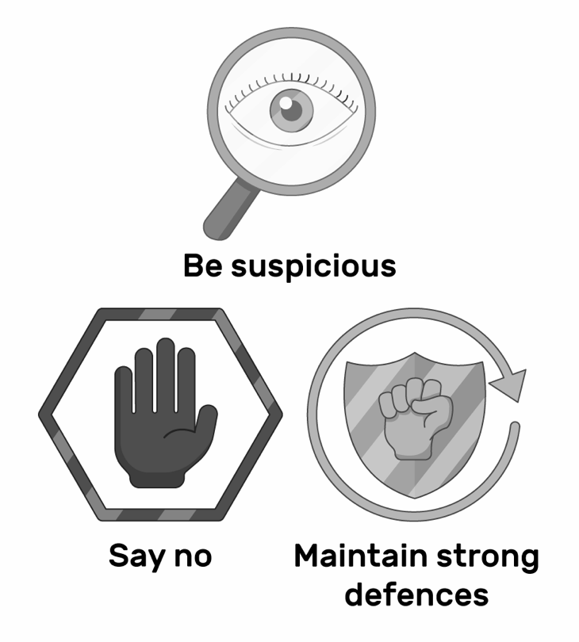
Task 2 - The cost of cybercrime and hacker motivation
The questions on the following two slides will help you to summarise and reflect on the learning from this lesson.
Don’t be afraid to look back over the slides to help you answer the questions.

Slide 4
Task 2 - part 1
What is your definition of cybersecurity?
What is your definition of network security?
Who does cybercrime affect?
Why does cybercrime cost businesses money?
Roughly what percentage of business and charities in the UK identified a cyberattack in the last twelve months?

Slide 5
Task 2 - part 2
Why are networks vulnerable?
Give three motives for cybercrime.

