Slide 1
To describe and classify 3-D shapes
Mathematics
Miss Charlton

Slide 2
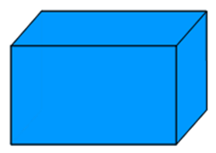
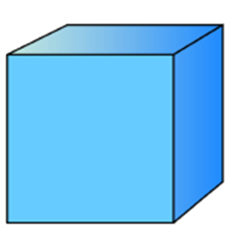
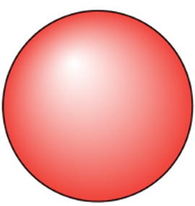
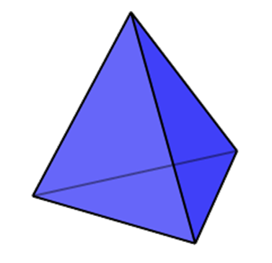
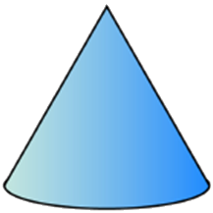
Independent task
has a curved surface
has no curved surface

Slide 3
Answers
has a curved surface
has no curved surface

