Slide 1
Solving comparison problems
Mathematics
Mrs Bramble and Miss Sidhu

Slide 2
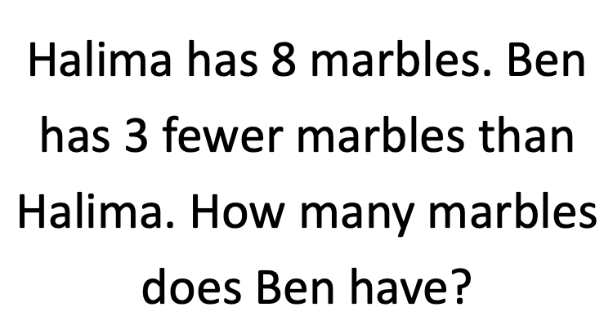
Independent Task
Create addition and subtraction equations for this word problem.

Slide 3
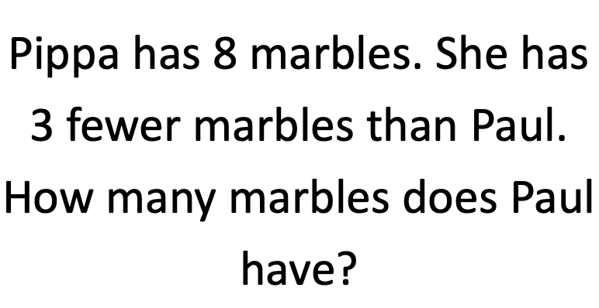
Independent Task
Create addition and subtraction equations for this word problem.

Slide 4
Support

Slide 5
Support

