Slide 1
Compound area problems
Mathematics
Mr Coward

Slide 2
Explain why the shaded area in each picture is the same.
10 cm
10 cm
Can you calculate the shaded area?

Slide 3
1) Find the area of the shaded section
72cm
8m
2cm
2cm
2cm
1cm
4m
9m

Slide 4
2) Find the area of these compound shapes
10 cm
4 cm
4 cm
12cm
13 cm
Perimeter of square = 32 cm
?
3cm

Slide 5
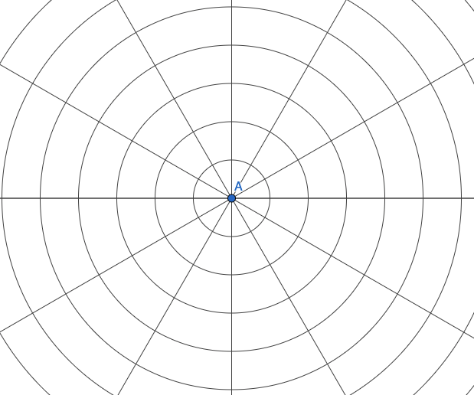
In which picture is the biggest area shaded?

