Slide 1
Find missing angles in a triangle
Maths
Mr Clasper

Slide 2
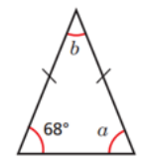
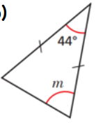
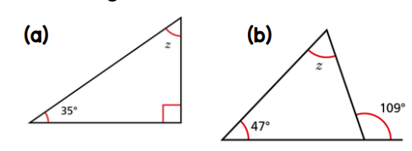
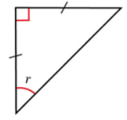
Find missing angles in a triangle
3. Find the missing angle in each of the isosceles triangles.
92°
31°
28°
47°
44°
68°
35°
47°
109°

Slide 3
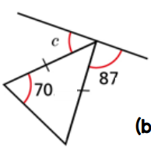
Find missing angles in a triangle
4. Find the missing angles in each diagram.
P
I
20°
87°
70°
103°
I
40°
S
Q
I
I
I
I
I
I
44°
I
I
R

Slide 4
Answers

Slide 5
Find missing angles in a triangle
3. Find the missing angle in each of the isosceles triangles.
92°
31°
28°
47°
44°
68°
35°
47°
109°

Slide 6
Find missing angles in a triangle
4. Find the missing angles in each diagram.
P
I
20°
87°
70°
103°
I
120º
40°
S
Q
I
92º
44º
I
I
I
I
I
44°
I
I
R

