Slide 1
Diffusion and exchange surfaces
Task 1: Describe diffusion
a) Define the term diffusion.
b) Describe, using ideas of diffusion, how you can smell food being cooked in a kitchen from other rooms of a house.
Task 2: Explain factors which affect the rate of diffusion
a) Complete the table summarising the factors affecting the rate of diffusion.
Factor | Explanation
increasing temperature
increasing surface area to volume ratio
increasing concentration gradient
Science Diffusion and exchange surfaces

Slide 2
Task 3: Calculate surface area to volume ratio
a) Complete the table for each cube.
Cube
Side length | 0.5cm | 1.4cm | 3cm | 12cm | 40cm
Surface area
Volume
SA : V
b) Describe the trend in surface area to volume ratio as the cubes increase in size.
Task 4: Explain adaptations of diffusion
a) Explain how alveoli in the lungs are adapted for efficient gas exchange.
b) Smoking can cause a disease called emphysema. This damages the alveoli, resulting in fewer, larger air sacs instead of many smaller ones. Explain why this often leaves sufferers of emphysema breathless.
c) Describe and explain how the villi are adapted to maximise the rate of absorption of the products of digestion.
Science Diffusion and exchange surfaces

Slide 3
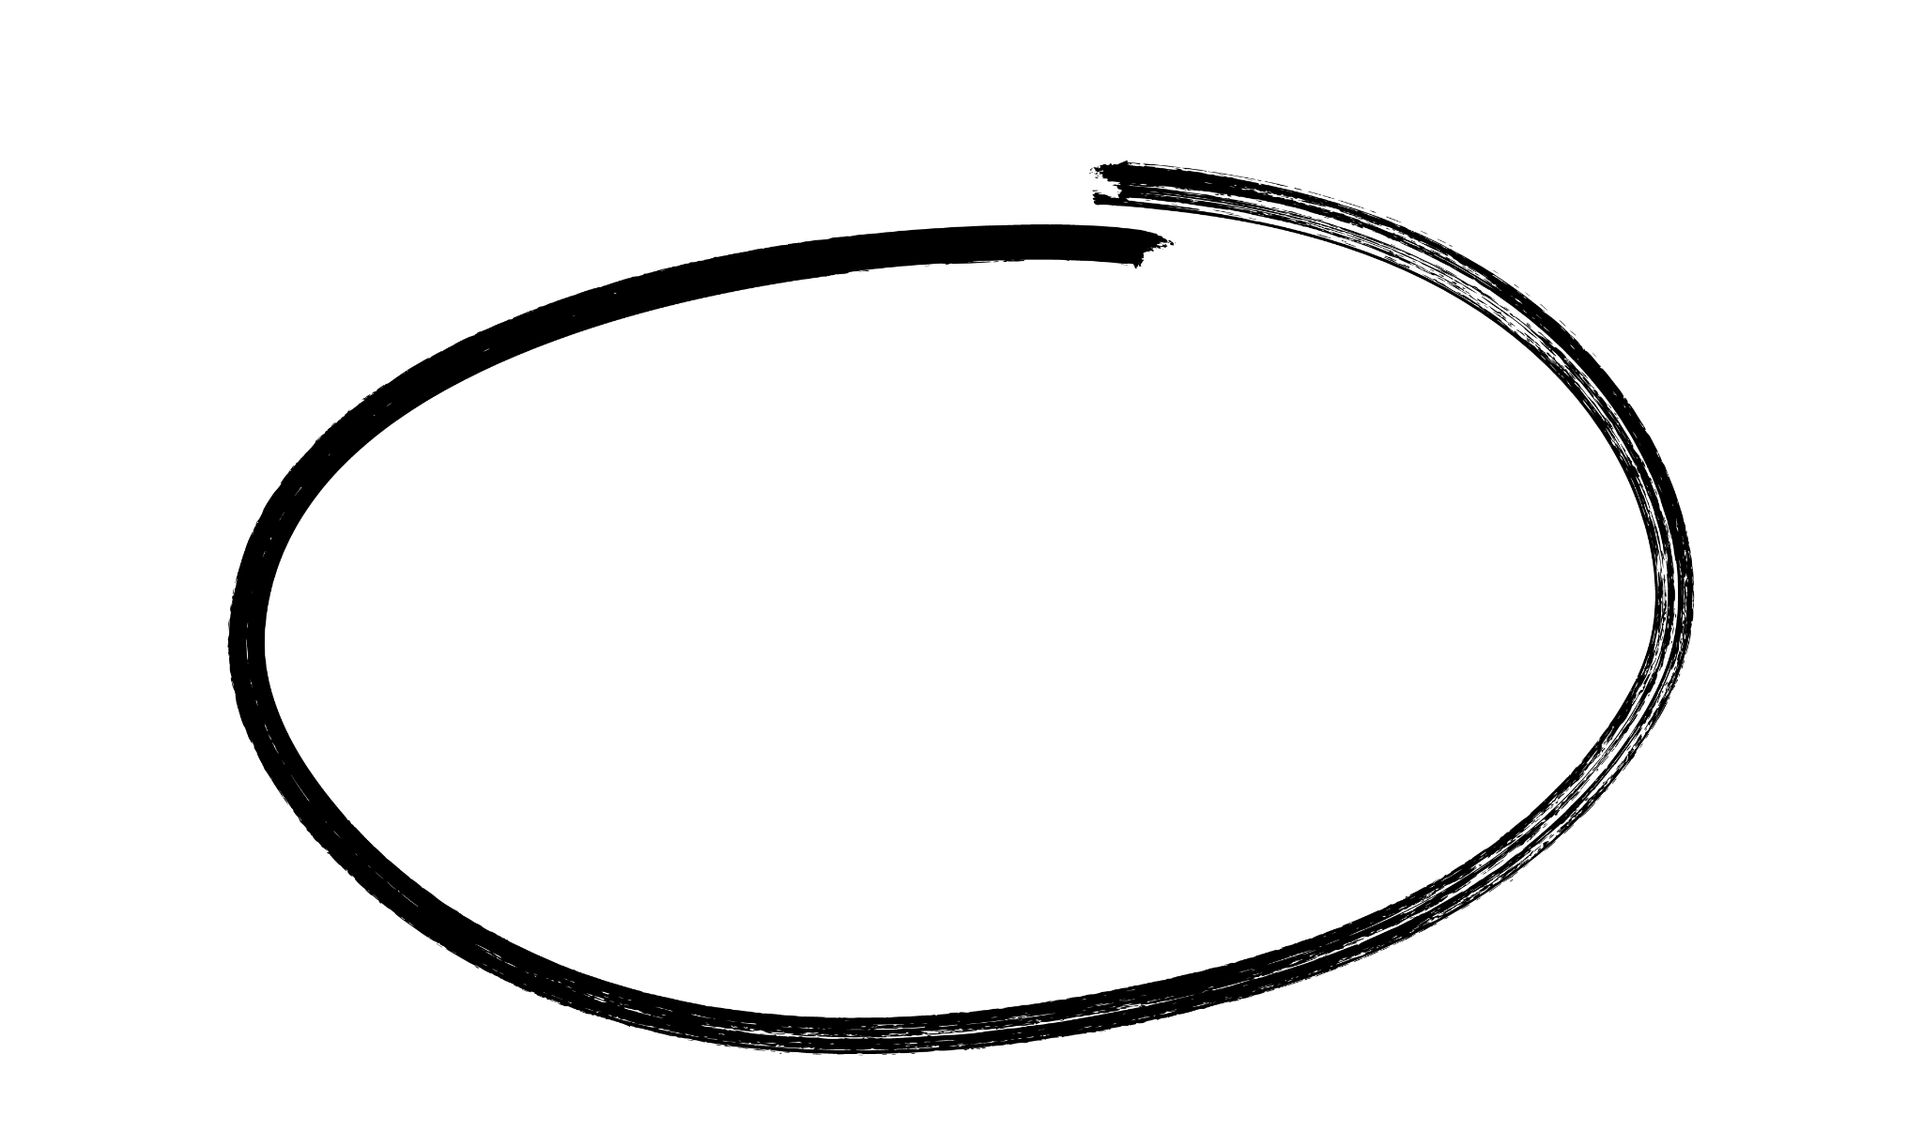
Diffusion and exchange surfaces
Answers
Task 1: Describe diffusion
a) Define the term diffusion.
Diffusion is the net movement of particles from an area of high concentration to an area of low concentration.
b) Describe, using ideas of diffusion, how you can smell food being cooked in a kitchen from other rooms of a house.
Particles from the food enter the air around it. There is a high concentration of particles around the food. The particles move from an area of high concentration to an area of low concentration by diffusion.
Task 2: Explain factors which affect the rate of diffusion
a) Complete the table summarising the factors affecting the rate of diffusion.
Factor | Explanation
increasing temperature
increasing surface area to volume ratio
increasing concentration gradient
Particles have more energy to move.
Particles have more places to move through cell membranes.
Higher difference in concentration means particles will move quicker.
Science Diffusion and exchange surfaces

Slide 4
Answers
Task 3: Calculate surface area to volume ratio
a) Complete the table for each cube.
Cube
Side length | 0.5cm | 1.4cm | 3cm | 12cm | 40cm
Surface area | 1.5 | 11.76 | 54 | 864 | 9600
Volume | 0.125 | 2.744 | 27 | 1728 | 64000
SA : V | 12 : 1 | 4.3 : 1 | 2 : 1 | 0.5 : 1 | 0.15 : 1
b) Describe the trend in surface area to volume ratio as the cubes increase in size.
As the size of the cube increases, the surface area to volume ratio decreases.
Task 4: Explain adaptations of diffusion
a) Explain how alveoli in the lungs are adapted for efficient gas exchange.
Many tiny alveoli give the lungs a large surface area.
They have a good blood supply (lots of capillaries) to maintain a concentration gradient.
The walls are thin (one cell thick) to give a short diffusion distance for the gases.
Moist surfaces would also be acceptable.
b) Smoking can cause a disease called emphysema. This damages the alveoli, resulting in fewer, larger air sacs instead of many smaller ones. Explain why this often leaves sufferers of emphysema breathless.
The surface area of the lungs is reduced.
This means less oxygen can diffuse into the blood.
c) Describe and explain how the villi are adapted to maximise the rate of absorption of the products of digestion.
many villi provide large surface area
many capillaries or good blood supply maintains a concentration or diffusion gradient
thin wall or one cell thick surface gives a short distance for substances to travel
Science Diffusion and exchange surfaces

