Slide 1
Measures:
Measuring objects using non standard units and using accurate language: Part 1
Mathematics Lesson 6 of 10
Miss. Molnar

Slide 2
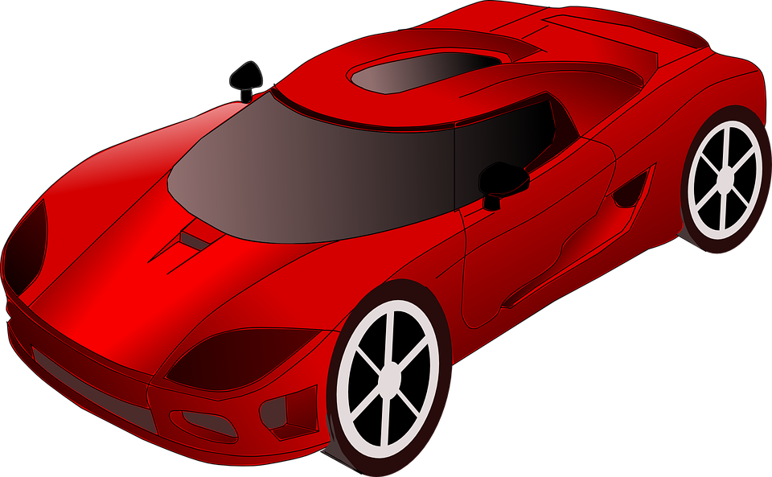
Can you measure and record the length of your toy cars? Can you order them from shortest to longest?
Source: Pixabay, Clker-Free-Vector-Images, Car racing red
Source: Pixabay, Clker-Free-Vector-Images, Paperclip

Slide 3
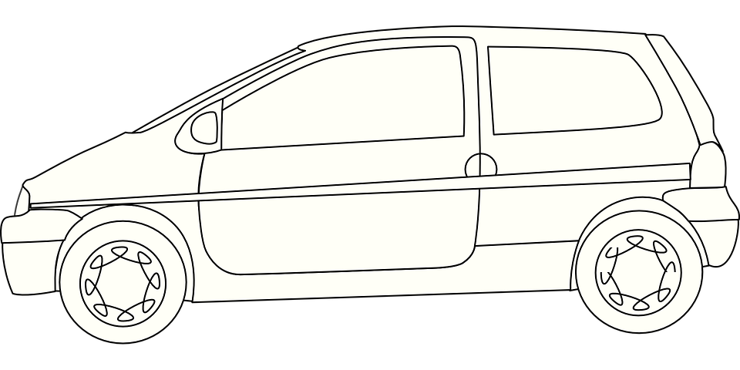
Source: Pixabay, OpenClipart-Vectors, Car vehicles

