Slide 1
To subtract a 1-digit number from a teens number using a known fact
Mathematics
Miss Charlton
Notes:
We are starting a new unit today, all about numbers to 20!

Slide 2
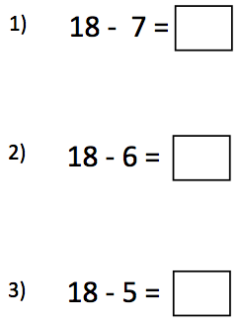
Independent task
Which number bond would help you solve each equation?
8 - 6
8 - 7
8 - 5

Slide 3
Answers
11
Which number bond would help you solve each equation?
8 - 6
8 - 7
8 - 5
12
13

