Slide 1
Ecological relationships and classification
Lesson 6 - Estimating Populations
Biology - Key Stage 3
Miss Lewis

Slide 2
Task
Calculate the frequency.
Calculate the total number of flowers.
Calculate the mean.
Number of flowers in the quadrat | Tally | Frequency | Total Number of Flowers
1
2
3
4
5
6
7
8
9
10
Totals:
Mean = Total number of organisms
Frequency

Slide 3
Task
Calculate the mean number of flowers from the frequency table.
Number of flowers in the quadrat | Tally | Frequency | Total Number of Flowers
1
2
3
4
5
6
7
8
9
10
Totals:

Slide 4
60m
250m

Slide 5
15m
10m
19m
26m

Slide 6
28m
9m
16m
10m

Slide 7
17m
20m
9m
37m

Slide 8
Step | Answer
1. Calculate area of your quadrat
2. Calculate the area of your sampling site
3. Calculate the number of quadrats that fit the sample area (multiplication factor) by: area of the sampling site ÷ area of the quadrat.
4. Find the mean of your random samples
5. Multiply the mean number by the number calculated in step 3 to calculate your estimated population of daisies. Round up your answer to the nearest whole number.

Slide 9
Estimate the population of daisies in the field
A 0.5 m x 0.5 m quadrat was placed randomly 10 times on the site shown and the numbers of daisies recorded were as follows:
5, 0, 2, 6, 9, 1, 7, 2, 0, 13
35 m
12 m

Slide 10
Step | Answer
1. Calculate area of your quadrat
2. Calculate the area of your sampling site
3. Calculate the number of quadrats that fit the sample area (multiplication factor) by: area of the sampling site ÷ area of the quadrat.
4. Find the mean of your random samples
5. Multiply the mean number by the number calculated in step 3 to calculate your estimated population of daisies. Round up your answer to the nearest whole number.

Slide 11
Estimate the population of daisies in the field
A 0.5 m x 0.5 m quadrat was placed randomly 10 times on the site shown and the numbers of daisies recorded were as follows:
6, 1, 4, 12, 7, 0, 8, 3, 0, 10
24 m
10 m

Slide 12
Step | Answer
1. Calculate area of your quadrat
2. Calculate the area of your sampling site
3. Calculate the number of quadrats that fit the sample area (multiplication factor) by: area of the sampling site ÷ area of the quadrat.
4. Find the mean of your random samples
5. Multiply the mean number by the number calculated in step 3 to calculate your estimated population of daisies. Round up your answer to the nearest whole number.

Slide 13
Estimate the population of daisies in the field
A 0.5 m x 0.5 m quadrat was placed randomly 8 times on the site shown and the numbers of daisies recorded were as follows:
12, 16, 8, 1, 9, 5, 2, 11
9 m
4 m

Slide 14
Step | Answer
1. Calculate area of your quadrat
2. Calculate the area of your sampling site
3. Calculate the number of quadrats that fit the sample area (multiplication factor) by: area of the sampling site ÷ area of the quadrat.
4. Find the mean of your random samples
5. Multiply the mean number by the number calculated in step 3 to calculate your estimated population of daisies. Round up your answer to the nearest whole number.

Slide 15
Estimate the population of daisies and dandelions in the field
A 0.5 m x 0.5 m quadrat was placed randomly 8 times on the site shown and the numbers of daisies and dandelions recorded were as follows:
Daisies: 0, 12, 3, 3, 9, 12, 8, 11, 0, 15
Dandelions: 1, 4, 2, 6, 6, 2, 3, 6, 4, 7
15 m
6 m

Slide 16
÷
Step | Answer
1. Calculate area of your quadrat
2. Calculate the area of your sampling site
3. Calculate the number of quadrats that fit the sample area (multiplication factor) by: area of the sampling site ÷ area of the quadrat.
4. Find the mean of your random samples
5. Multiply the mean number by the number calculated in step 3 to calculate your estimated population of daisies. Round up your answer to the nearest whole number.

Slide 17
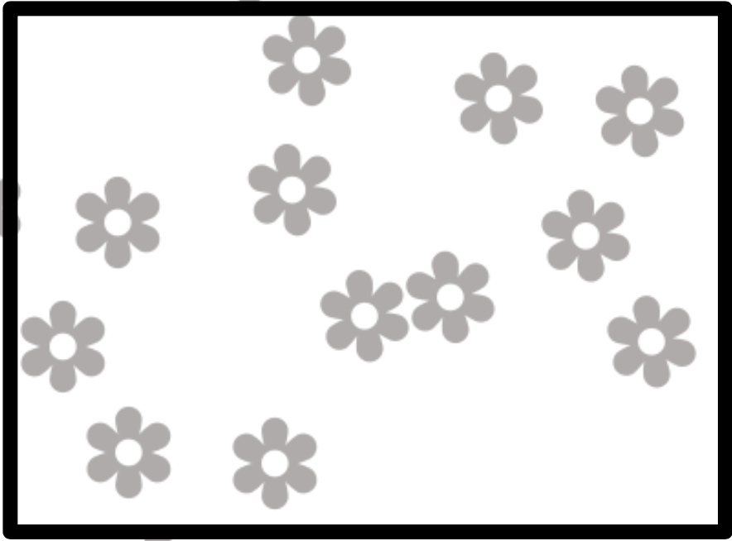
Exam Style Question
The green in town measures 160 x 60 metres.
A student wanted to estimate the number of daisies are growing on the green. The student found an area where daisies were growing and placed a 1 m x 1 m quadrat in one position in that area. The image shows the daisies in the quadrat.
The student said: ‘This result shows that there are 115 200 daisies on the green. How did the student calculate this?
Hint: Think about the table.

Slide 18
Exam Style Question
The green in town measures 160 x 60 metres.
A student wanted to estimate the number of daisies are growing on the green. The student found an area where daisies were growing and placed a 1 m x 1 m quadrat in one position in that area.
The student’s estimate is probably not accurate. How could you improve the student’s method to give more accurate results?

