Slide 1
Identifying multiples and factors
Worksheet
Mr Ward

Slide 2
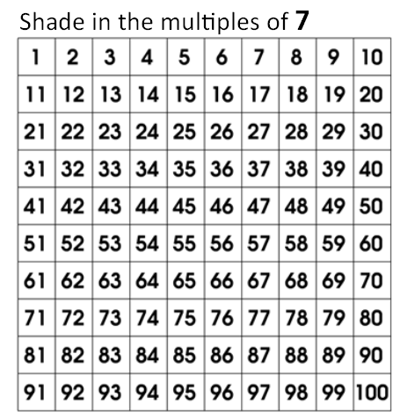
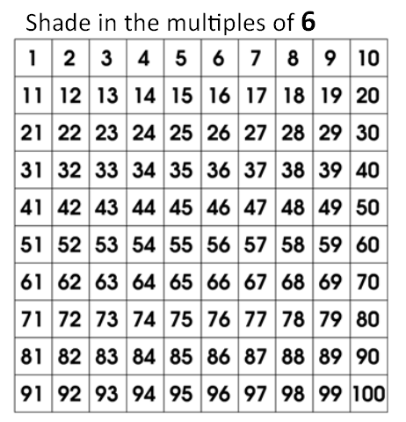
Warm up - Identify the correct multiples
Circles the multiples of 7
Circles the multiples of 6

Slide 3
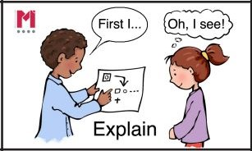
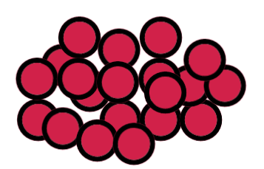
Independent Talk Task
How many different arrays can you make with counters?

Slide 4
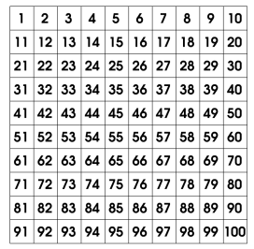
Use your knowledge of multiples and factors
Identify the mystery number
Puzzle 1
I'm thinking of a number less than 100.
It is a multiple of 8.
12 is a factor of this number.
It is also a multiple of 9.

Slide 5
Use your knowledge of multiples and factors
Identify the mystery number
Puzzle 2
I'm thinking of a number less than 100.
It is a multiple of 4.
6 is a factor of this number.
It is also a multiple of 42.

Slide 6
Use your knowledge of multiples and factors
Identify the mystery number
Puzzle 3
I'm thinking of a number less than 100.
It is a multiple of 7.
4 is a factor of this number.
It is also a multiple of 8.

Slide 7
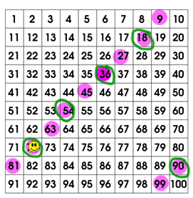
Challenge Slide
Can you work out what the clues would
be for 72 to be the mystery number?
I'm thinking of a number less than 100.
____
____
____

