Slide 1
Line graphs and timetables
Consolidation and review
Worksheet
Mr Ward

Slide 2
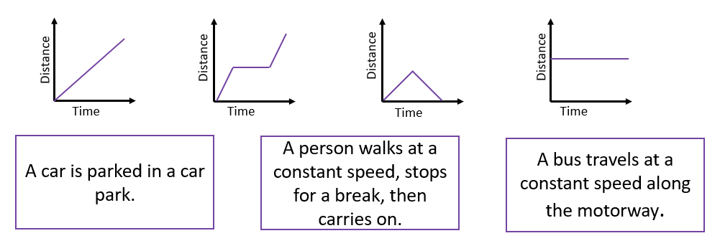
Match each Maths Story to the line graph.
Explain how you know?

Slide 3
Can you now create a maths story for the remaining graph?

Slide 4
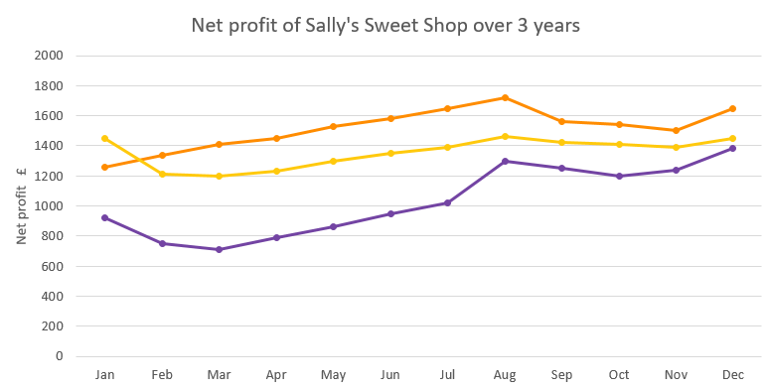
Decide whether the statements are true or false.
Net profit of Sally’s Sweet Shop over 3 years
Net profit (£)
Months of the year
The quietest December for Sally’s sweet shop was in 2016.

Slide 5
Decide whether the statements are true or false.
Net profit of Sally’s Sweet Shop over 3 years
Net profit (£)
Months of the year
Easter is always the busiest time of the year for the shop

Slide 6
Decide whether the statements are true or false.
Net profit of Sally’s Sweet Shop over 3 years
Net profit (£)
Months of the year
In 2017 the total net profit across the year was under £10,000

Slide 7
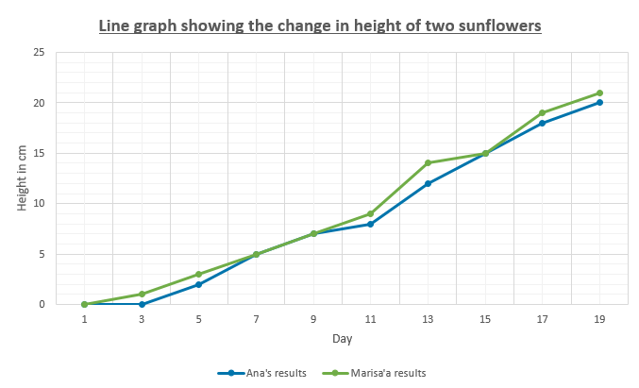
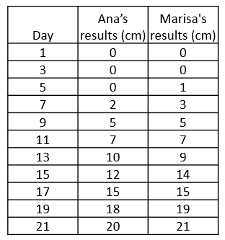
Two girls recorded the height of a sunflower over 19 days. Spot the first mistake in the graph.
Line graph showing the change in height of two sunflowers
Height (cm)
Day

Slide 8
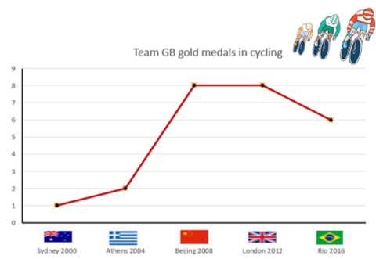
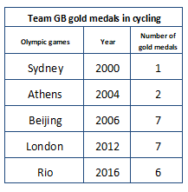
Look carefully at the line graph below.
Can you spot any errors?
Team GB gold medals in cycling
Number of medals
Olympic Years

Slide 9
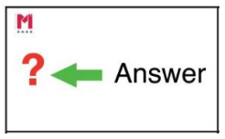
What’s the question?
Team GB gold medals in cycling
The answer is 6 medals
The answer is 7 medals
Number of medals
Olympic Years

Slide 10
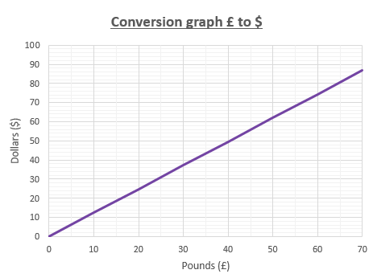
Explore the conversion graph
Answer the questions.
Conversion graph £ to $
Jake has 80 pounds that he wants to exchange for dollars.
Estimate how many dollars he would receive.
Would it be greater or less than 80?
Dollars ($)
Pounds (£)

Slide 11
Explore the conversion graph
Answer the questions.
Conversion graph £ to $
Jake has $100 left from his holiday and wants to convert it pack to pounds so he can buy a new Television which is on sale for £89.99
Will he have enough?
Dollars ($)
Pounds (£)

Slide 12
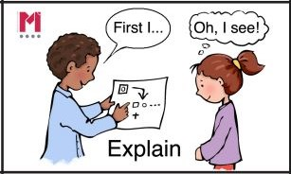
Identifying time intervals
using blank number lines

Slide 13
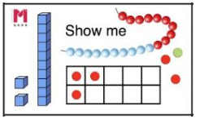
Using time intervals

Slide 14
Using time intervals

Slide 15
Using time intervals

Slide 16
Read the bus timetable below carefully.
Decide whether the statements are true or false.
Travelling from Uxbridge to Ealing Broadway, I can save 28 minutes by travelling on the fast bus.

Slide 17
Read the bus timetable below carefully.
Decide whether the statements are true or false.
If I get on the 10:30 bus, it takes me 35 minutes to get to West Ealing.

Slide 18
Read the bus timetable below carefully.
Decide whether the statements are true or false.
If I want to travel from Hayes to West Ealing for an appointment at 09:00, I can get on the 08:47 bus.

