Slide 1
Using Number Bonds Within 20 for Addition
Independent Task
Mathematics
Miss Hughes

Slide 2
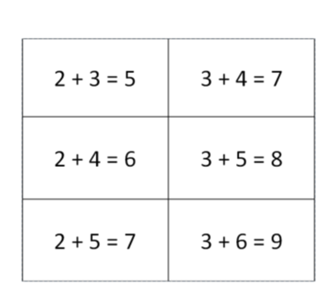
If I know… what else do I know?
Derive facts within 20 from the equations given.
Challenge
How many different ways can you write your equations?
Draw your tens and ones for each.
If I know ………… Then I know………....

Slide 3
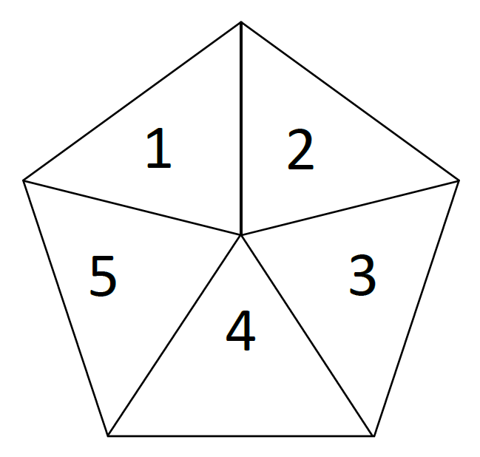
Spinner template

