Slide 1
Biology- Key Stage 3
Lesson 1 - Plants and Photosynthesis
Plant Roots
Miss White

Slide 2
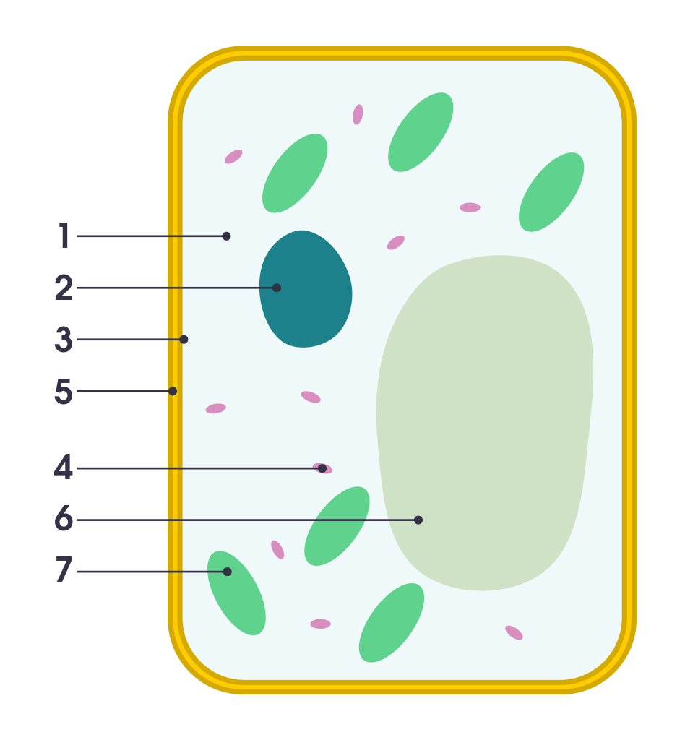
Name the parts of the plant cell
__________________________
__________________________
__________________________
__________________________
__________________________
__________________________
__________________________

Slide 3
Match the organelle to its function
Organelle | Function
Cytoplasm
Nucleus
Cell Membrane
Mitochondria
Cell Wall
Vacuole
Chloroplasts

Slide 4
Self-assess
What is the role of the root hair cell?
State two adaptations a root hair cell has
Explain why one of these adaptations is important

Slide 5
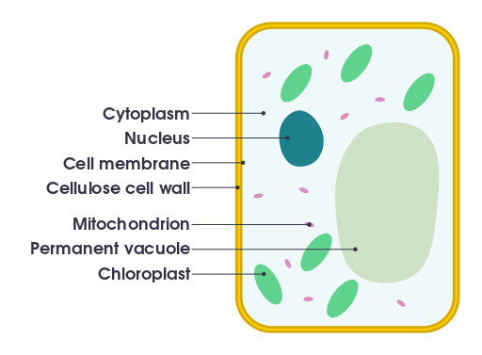
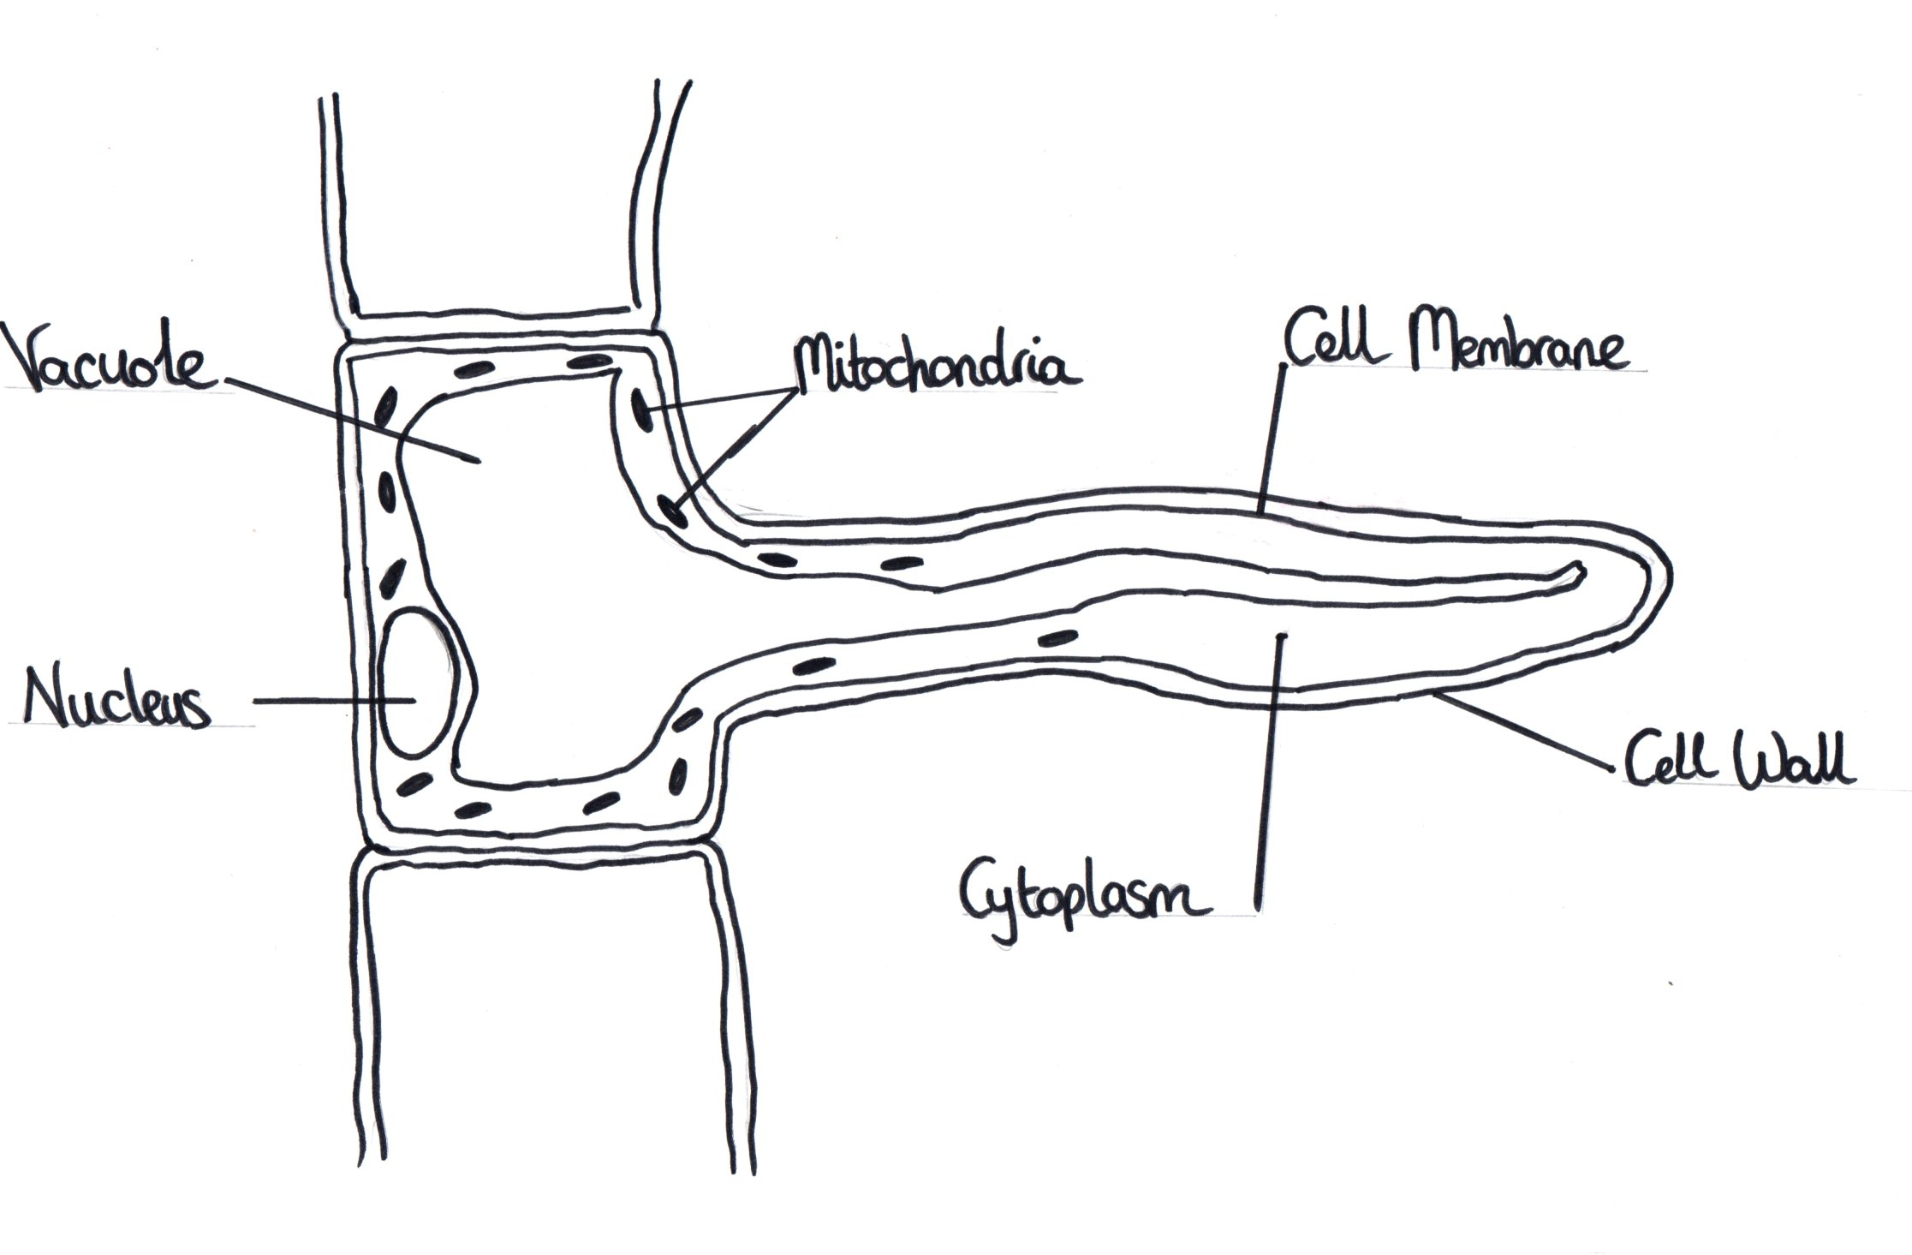
Compare a root hair cell to a typical plant cell
A root hair cell is similar to a typical plant cell because…
A root hair cell is different to a typical plant cell because…
Drawn by R White

Slide 6
Have a go...
What is the role of the roots? The role of the roots is to absorb ______ and ______ from the ______.
By which process does water enter the roots? Water enters the plant by _____________.
Why does having a long membrane help the root hair cells to take in more water? Roots have a long membrane because...
Why do root hair cells have lots of mitochondria? Root hair cells have lots of mitochondria because...

