Slide 1
Percentages and statistics
Interpret pie charts
Independent Task
Mathematics
Ms Parsons

Slide 2
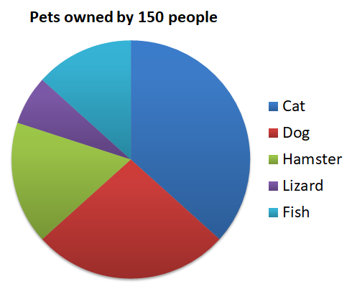
Question 1
Identify those that are true and rewrite those that are false.
Approximately 40% of people own a dog.
Approximately a third of people own a cat.
About 10% of people own either a hamster or a lizard.
Approximately 75 people own a cat.
One person owns a lizard.
Twice as many people own a dog than a fish.

Slide 3
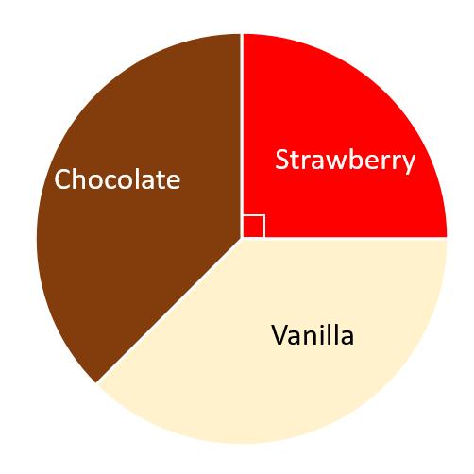
Question 2
An ice cream stall sells vanilla, strawberry and chocolate ice creams.
The pie chart illustrates the sales of ice cream today.
The number of vanilla and the number of chocolate ice creams sold were the same.
The stall sold 60 strawberry ice creams.
How many chocolate ice creams were sold?
NRICH

Slide 4
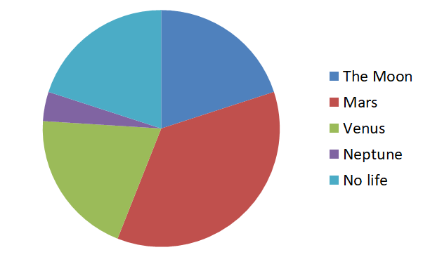
In a survey, people were asked where they believed life could be found beyond Earth.
Ten people believe life could be found on the Moon.
Use this information to approximate the number of people in the survey.
Question 3

Slide 5
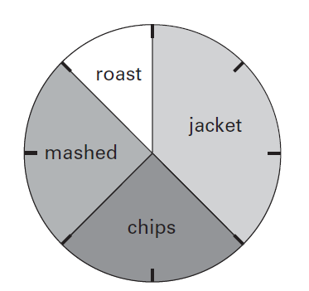
Question 4
32 children took part in the survey.
Look at the four statements below.
For each statement put a tick if it is correct. Put a cross if it is not correct.
This pie chart shows how the children in Class 6 best like their potatoes cooked.
10 children like chips best.
25% of the children like mashed potato best.
of the children like roast potatoes best.
12 children like jacket potatoes best.

