Slide 1
Finding the Volume of Triangular Prisms
Maths
Miss Davies

Slide 2
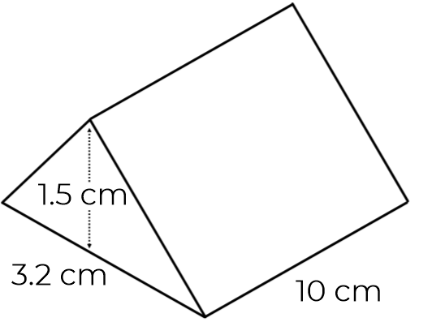
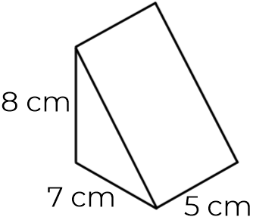
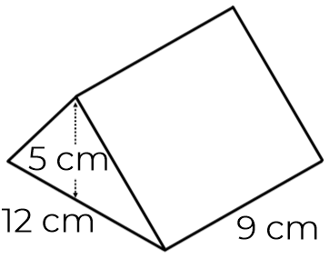
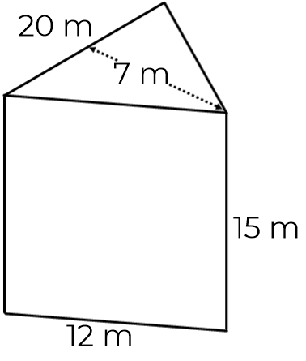
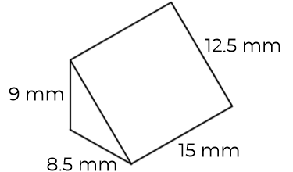
Finding the Volume of Triangular Prisms
1. Calculate the volume of the triangular prisms.
a) b)
c) d)
2. Tom and Lisa are finding the volume of the triangular prism.
Their working out is shown.
Who is correct?
3.2 cm
10 cm
8 cm
7 cm
12 cm
9 cm
5 cm
20 m
12.5 mm
9 mm
15 m
8.5 mm
15 mm
12 m

Slide 3
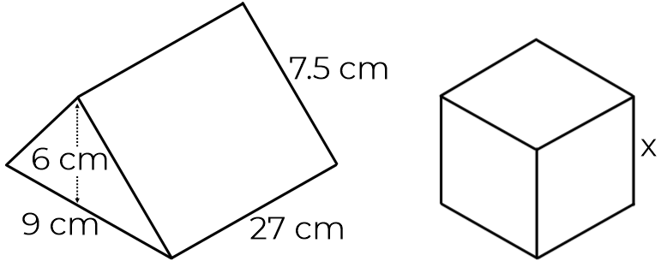
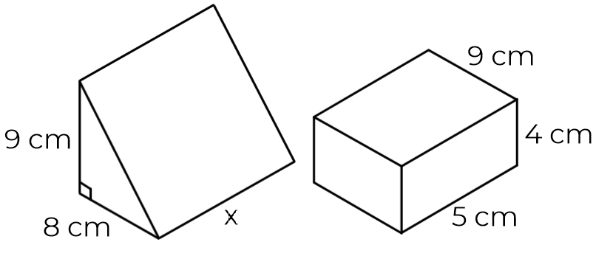
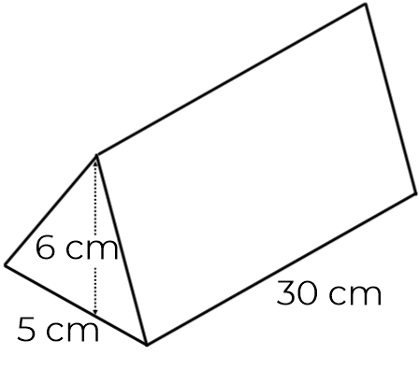
Finding the Volume of Triangular Prisms
3. The triangular prism and cuboid have the same volume.
Find the length x.
4. The triangular prism and cube have the same volume. Find the length x.
5. The dimensions of a chocolate bar are shown below.
Chocolate has the density 1.3g/cm³.
What is the mass of the bar?
7.5 cm
9 cm
4 cm
9 cm
27 cm
9 cm
8 cm
5 cm
5 cm
30 cm

Slide 4
Answers

Slide 5
Finding the Volume of Triangular Prisms
1. Calculate the volume of the triangular prisms.
a) b)
c) d)
2. Tom and Lisa are finding the volume of the triangular prism.
Their working out is shown.
Who is correct?
270 cm³
3.2 cm
10 cm
8 cm
140 cm³
7 cm
12 cm
9 cm
5 cm
20 m
573.75 mm³
1050 m³
9 mm
15 m
8.5 mm
15 mm
They are both correct – both calculations give 24 cm³ as an answer.
12 m

Slide 6
Finding the Volume of Triangular Prisms
3. The triangular prism and cuboid have the same volume.
Find the length x.
4. The triangular prism and cube have the same volume. Find the length x.
5. The dimensions of a chocolate bar are shown below.
Chocolate has the density 1.3g/cm³.
What is the mass of the bar?
7.5 cm
9 cm
4 cm
9 cm
27 cm
x = 9 cm
9 cm
8 cm
5 cm
x = 5 cm
585 g
5 cm
30 cm

