Slide 1
TAWHID
RELIGIOUS EDUCATION
Worksheet
MR LATIF

Slide 2
Resource Sheet - What is Tawhid?
He is without beginning or end.
Surah Ikhlas (Sincerity)
“Say: He is Allah, the One; Allah, the Eternal, the Absolute; He begets none, nor is He begotten. And there is none like unto Him.”
[Qur’an Surah 112]
Need some help with some of the terms?
This tells Muslims not to think of Allah in human terms.
Begotten: cause, bring about
Begot: past of Beget
Beget: a man whose existence was caused by process of reproduction
This is to reject the Christian idea of the Trinity that God is the ‘Father’, Jesus as ‘the Son’ and the Holy Spirit
He is not limited by time or place.
Task 2: Muslims believe in Tawhid which means……... Muslims believe that Allah has …………………. which can be found in the holy book known as the……….. A good example of this is found in the ……………… prayer which tells Muslims that Allah is the Most Merciful and the Most……..

Slide 3
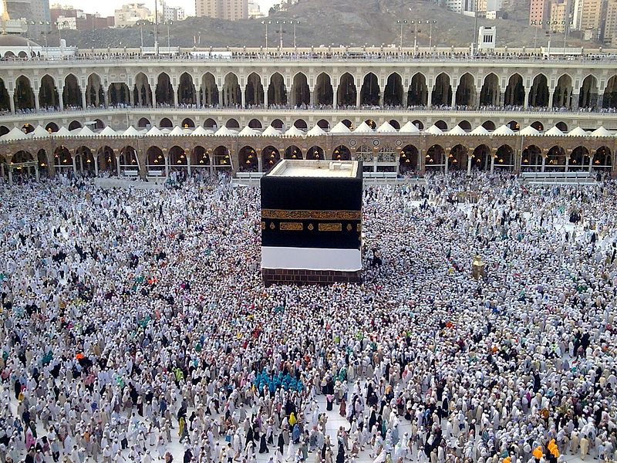
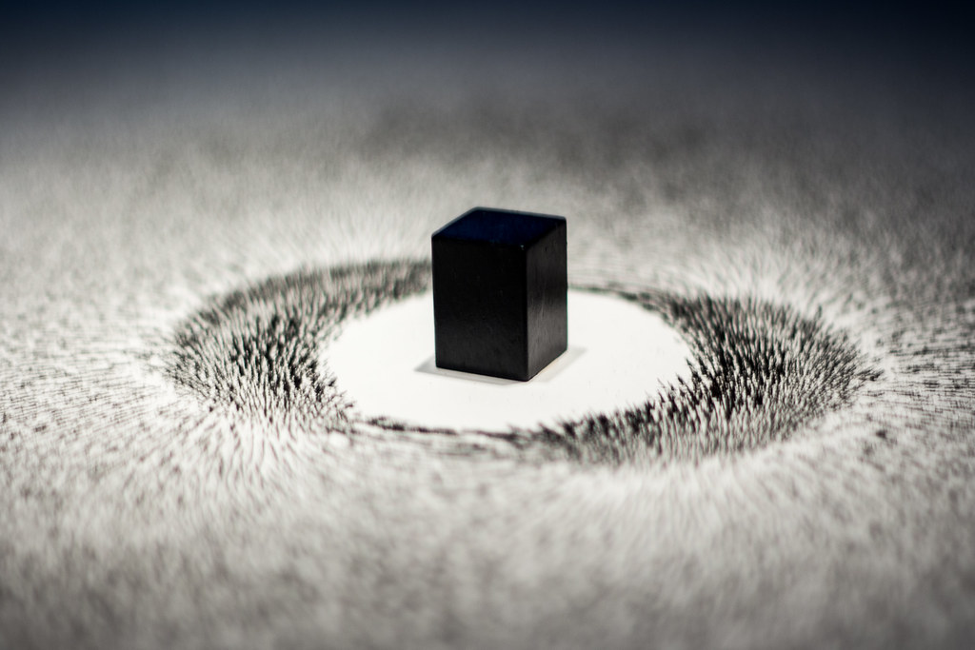
Resource Sheet 2 - Tawhid in Art
How does the artist in the image of the right show the concept of Tawhid?
What do you notice in terms of the similarity with the live photo of the Kaaba on the left hand side?
What do you think the artist is trying to portray?
Credit: Najamuddin Shahwani / CC BY (Attribution 3.0 Unported (CC BY 3.0))
Credit: [Flickr - Hans Splinter] - [Longing for the Mecca by Ahmed Materi] (Attribution-NoDerivs 2.0 Generic (CC BY-ND 2.0))

Slide 4
Resource Sheet 3 ‘Allah’s Transcendent and Immanent Nature Part 1”
Immanent means - close at hand, present in the universe, within the world, part of human life.
Transcendent means - beyond the universe, separate and outside of the world.
I feel the presence of Allah
close to me as I live my life
Allah is closer to us than our jugular vein.
Allah knows all humankind
He is Allah, the One and Only.
“No vision can grasp Him, But his grasp is over all Vision, He is above all comprehension, yet is acquainted with all things” [Qur’an Surah 6:103 Sahih International Translation]
Outside time
“When my servants ask you [O Muhammad] about me I am close. I listen to every prayer of every suppliant” [Qur’an Surah 2:186 Sahih International Translation].
“We are closer to him than his jugular vein.” [Qur’an Surah 50:16 Sahih International Translation]
The power behind the universe
Rules and regulates
all affairs
Outside and beyond everything that He created
the Eternal, the Absolute
Beyond human reasoning and understanding
Allah is closer to each human than their heartbeat.
Allah is beyond comparison
with all other living things.

Slide 5
Resource Sheet 4 ‘Allah’s Transcendent and Immanent Nature Part 2’
Task: Fill in the gaps with the words down below. Afterwards write down your own opinion to this question, “Do you think you can ever know God?”
Muslims believe that Allah is Immanent and transcendent.
Allah is outside the limits of this world including the rules of nature or time. For example, the Qur’an states in Surah 112, ‘He is Allah, the One and Only; Allah, the Eternal, the Absolute.’ This passage explains how Allah was neither born nor is the father to any other creation. Allah is beyond comparison with any other living thing.
At the same, Muslims believe Allah is immanent, which is to say Allah is close to human life and active in human affairs. The Qur’an also states ‘We are closer to him than his jugular vein. (Surah 50.16) Allah knows everything that is done and said. Nothing is hidden from him.
from / human / time / including / both / outside / the / Eternal / Allah / jugular / affairs / Allah / in / other / done

Slide 6
All quotations are taken from The Quranic Arabic Corpus.

