Slide 1
Order in a Restaurant (Part 1 / 3)
The differences between “Ser and Estar”
Downloadable Resource
Spanish
Señor Malhi
Notes:
Hola y bienvenidos. Me llamo Señor Malhi. ¿Qué tal? In this lesson we are going to work on Module 6 of the GCSE Specification - Special Events. This is the first lesson on how to order in a restaurant and our focus will be on using the past preterite with reflexive verbs. I hope you are in a quiet space without distractions, and have a pen and paper or your exercise book to hand. E.g. Hola. Soy [Doctora Hawkes] ¿Cómo estás? In this lesson we [practise the present tense with some regular verbs so we can talk about what people do]. I hope you are in a quiet space without distractions, and have a pen and paper to hand.

Slide 2
[i]
infante
Notes:
Our main phonics focus for today is the sound “i”. This is a very important phoneme as it is soft. Do you agree? Let’s practice together. “i”, repite, “infante” repite. Muy bien!

Slide 3
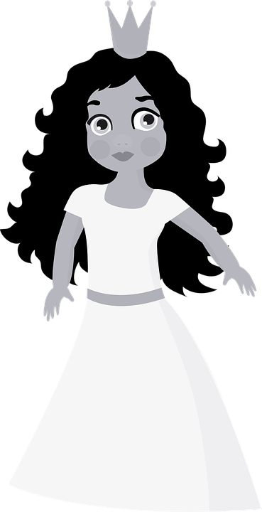
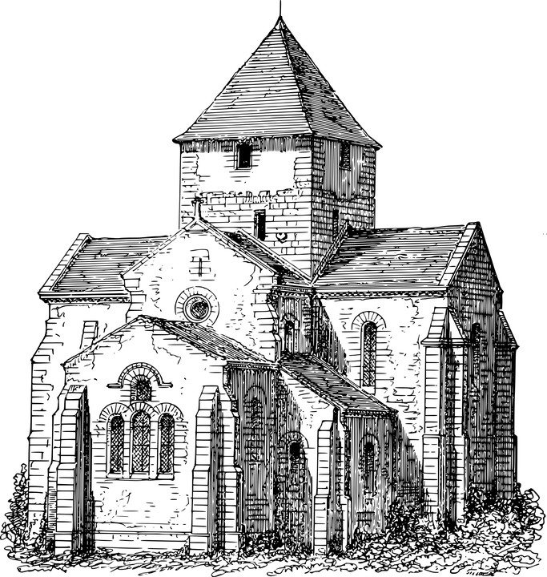
[i]
iglesia
princesa
India
imagen [image]
camisa
Notes:
Let’s look at some examples together. How would you pronounce this first word, which means “church”? We pronounce this words as “iglesia”. Can you say this word out loud? Escucha y repite. What about this example, the Spanish word for “India”? We pronounce this word as “India”. Escucha y repite. Our next example is the Spanish word for “image” and is pronounced “imagen”. Escucha y repite por favor. Our next word means “shirt”. It is pronounced “camisa”, escucha y repite. Our final example is the Spanish word for “princess” and is pronounced “princesa”, escucha y repite. Fantastico.
Phonics practice slide [Presentation slide to practice cluster words] Nothing below the acorn! NB: Any ambiguity (in your mind) about the the picture, then add the English word as well - and you can remove the picture, if you want.
Phonics template - grapheme in the middle - space for NCELP picture. These words have been chosen based on their frequency and the fact that there are limited other ‘sounds’ within the word. All pictures are copyright free. Timing: 1 minute
Procedure: 1. Say the SSC sound 2. Ask student to repeat (use TL for ‘repeat’). 3. Bring on five CLUSTER words which have the same sound. Ask student to repeat. Then you say each word and leave space for the student to say them after you.

Slide 4
el marisco | shellfish
el camarero, la camarera | waiter, waitress
el plato | plate, dish
el jamón | ham
la carne | meat
la tortilla | omelette
los calamares | squid rings
las gambas | prawns
sucio/a | dirty
roto/a | broken
Notes:
Min font size = 28 for the words on the slide. Nothing below the acorn.
On the screen, you can see the new vocabulary together. Now, I’ll say the Spanish again, but I will say them out of order. You say the correct translation out loud. If you want to challenge yourself - close your eyes, focus on what I’m saying and say the correct translation out loud.
LE.g. les grands événements
E.g. les grands événements

Slide 5
SER and ESTAR
If the food is plural, change “está” to “están” and “es” to “son”
In Spanish, there are two ways to say ‘it is’:
está
es
____________ and ____________
está
Use __________ to describe food at a specific time or instance.
es
Use _________ to describe food’s general characteristics.
The meat is cold (right now).
The meat is delicious (in general).
La carne está fría.
La carne es deliciosa.
Notes:
In Spanish, when describing food, there are two ways to say “it is”: “esta” and “es”
Use “esta” to describe food at a specific time or instance. For example, to say the meat is cold, we would say: “la carne esta fria”.
Use “es” to describe food’s general characteristics. To say the meat is delicious, the correct translation would be “la carne es deliciosa”.
Please now make a note of this rule in your books. Escribe esta regla en el cuaderno. Pausa el video.

Slide 6
¿En general o hoy?
 |  | In general | today
1. | La tortilla está deliciosa.
2. | Las gambas son sabrosas.
3. | El vino es amargo.
4. | El jamón está soso.
5. | Los calamares están fríos.
6. | El chocolate es muy dulce.
Notes:
Lets do some practice. Read the sentences. For each one, decide if they talk about what a food is like in general, or what it is like today. Let’s do the first one together. La tortilla esta deliciosa. The verb is ‘estar’, which is for temporary states. This means that we are talking about a particular tortilla, the one that we are eating today, it’s delicious. Now you’re going to complete numbers 2-6 and then we’ll check the answers. Pausa el video. HERE we need there to be a break. But obviously you only need to leave a couple of seconds as they will actually pause the video at that point. Then you go straight on and reveal / explain the answers. OK. Let’s look at the answers. 2. Las gambas son sabrosas. This is SER so we are talking about gambas, prawns, in general. They are tasty. 3. El vino es amargo. ES is from SER so again, we are talking about vino, wine, in general are being bitter-tasting. 4. El jamon esta soso. This is ESTAR so we mean this particular ham that we are eating today is bland, not that all ham is generally bland. 5. Los calamares estan frios. Again, this is ESTAR so the state of the squid rings today is cold. 6. El chocolate es muy dulce. This is SER so we are talking about all chocolate generally being sweet.
Muy bien, give yourselves a mark out of 5.

Slide 7
Translation Practice
Translate the sentences below into English.
El curry es picante.
Camarero, mi vaso está sucio.
Estas patatas fritas están deliciosas.
Los calamares están sabrosos hoy.
No puedo ser vegetariano porque la carne es deliciosa.
Notes:
On the screen you can see 3 sentences. Using the new knowledge you have learnt this lesson, I would like you to write each of these sentences in English. Pausa el video ahora y vamos.
Teacher says sentence slowly in TL.
Then presses return. Timer starts to count down automatically. When the word ESCRIBE pops up - teacher then tells the class to write in the TL.
Teacher counts to 10 in their head. Then go through the answer on the next slide.

Slide 8
Respuestas
Curry is spicy.
Waiter, my glass is dirty.
These chips are delicious.
The squid rings are tasty today.
I can’t be vegetarian because meat is delicious.
Notes:
Y la respuesta. Highlight in a different colour the aspect of the sentence you want to focus on and / or a tricky element.
Tell the student to say the English meaning out loud. Then you confirm the meaning: As a person my brother is very happy and active.

Slide 9
Translation Practice
Translate the sentences below into Spanish.
The omelette is tasty today.
Coffee is not very bitter.
The chile con carne is spicy today.
Cakes are sweet but very delicious.
The plates are broken.
Notes:
On the screen you can see 5 sentences. Using the new knowledge you have learnt this lesson, I would like you to write each of these Spanish sentences into your books, and translate them into English. Pausa el video ahora y vamos.
Teacher says sentence slowly in TL.
Then presses return. Timer starts to count down automatically. When the word ESCRIBE pops up - teacher then tells the class to write in the TL.
Teacher counts to 10 in their head. Then go through the answer on the next slide.

Slide 10
Respuestas
La tortilla está sabrosa hoy.
El café no es muy amargo.
El chile con carne está picante hoy.
Los pasteles son dulces pero muy deliciosos.
Los platos están rotos.
Notes:
Y la respuesta. Highlight in a different colour the aspect of the sentence you want to focus on and / or a tricky element.
Tell the student to say the English meaning out loud. Then you confirm the meaning: As a person my brother is very happy and active.

Slide 11
Respuestas
Spanish has two verbs meaning ‘ ________’
Use _______ to describe food at a specific time.
_______ means ‘it is’ as a general description.
“La carne está sucia” means: _____________________________________
‘Los calamares son deliciosos” means: ________________________________________
to be
está
es
The meat is dirty
The squid rings are delicious
Notes:
Use a sentence gap fill to consolidate / check understanding.
“On the screen you can see 5 sentence starters. I want you to copy down the sentence starter and then complete rest of the sentence. Pause the video now.”

