Slide 1
Talking about accommodation: reservations and problems [1/3] Worksheet
Using ‘me gustaría’ VS. ‘me gusta’
Asking questions
Spanish
Señorita Vázquez

Slide 2
La fonética
[cua]
[cue]
[cui]
cuatro
cuerpo
cuidado

Slide 3
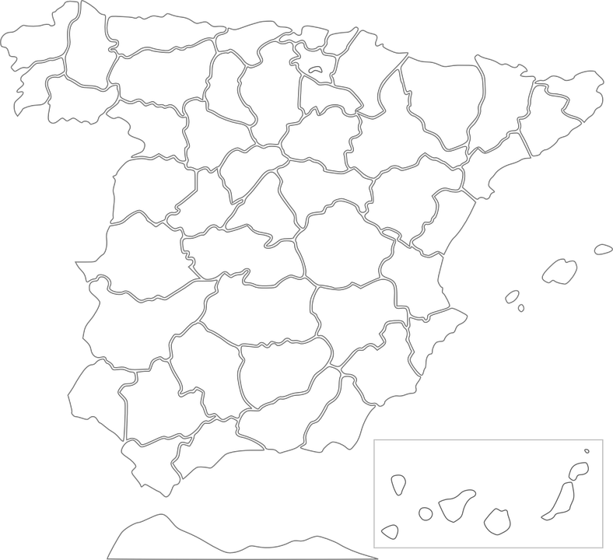
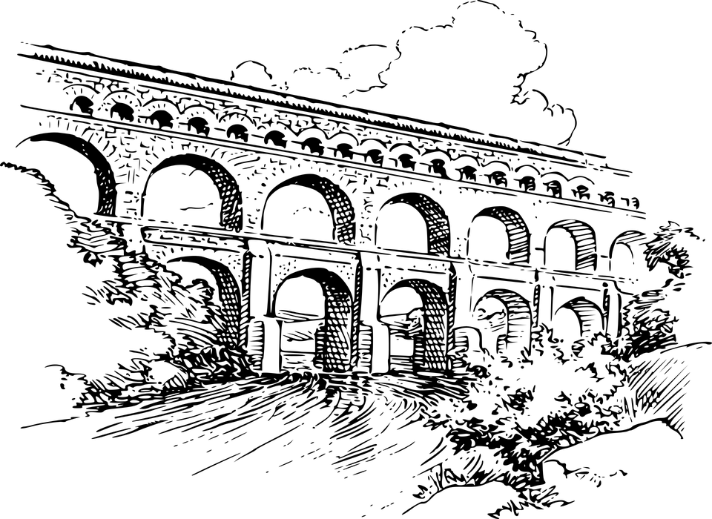
La fonética
Segovia
Cuenca
4
acueducto
Cua
rt
de Poblet
2
3
1
La Cuesta

Slide 4
la habitación | room
la cama | bed
quisiera | I would like
el desayuno | breakfast
incluído | included
la vista | view
despacio | slow
la media pensión | half board

Slide 5
Me gustaría(n) VS. me gusta(n)
‘Me gustaría’ is the conditional tense of ‘gustar’.
Me gusta(n)
Me gustaría(n)
Use me gusta to talk about things you like in general.
Use ‘me gustaría’ to express something that you would like / like to do.
Me gusta nadar en el mar.
Me gustaría nadar en el mar.
I like swimming in the sea. / Swimming in the sea pleases me.
I would like to swim in the sea. / Swimming in the sea would please me.
Remember that after gustar-type verbs we use the infinitive form of the verb.

Slide 6
Yes/no questionss
In Spanish, change a statement into a question by raising your voice at the end:
Spanish uses two question marks – the one at the front is upside down!
Statement
Hay wifi.
There’s wifi.
Question
¿Hay wifi?
Is there wifi?
In Spanish, we pay attention to the question marks in writing and the intonation in speaking to know whether it is a question.

Slide 7
Las respuestas
la habitación
la cama
quisiera
el desayuno
incluído
la vista
despacio
la media pension
la televisión | TV
el aire acondicionado | air conditioning
una habitación doble | a double room
una habitación individual | a single room
(el) servicio de habitaciones | room service

Slide 8
Respuestas
We use ‘me gustaría’
to refer to future intentions.
we use ‘me gusta’
to talk about what we like in general.
We pay attention to the question marks in
writing.
We pay attention to the intonation in
speaking.

