Slide 1
Add two surds
Worksheet
Maths
Mr Chan

Slide 2
Add two surds

Slide 3
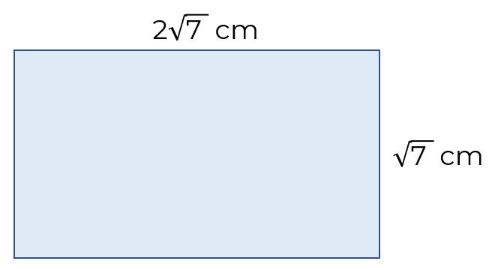
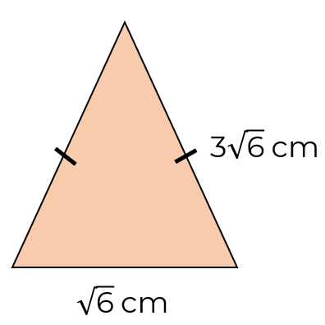
Add two surds
3. Work out the perimeter of each shape.
a)
b)
4. Here are some number cards.
Work out
the mode of the cards
the median of the cards
the total of the cards

Slide 4
Answers

Slide 5
Add two surds

Slide 6
Add two surds
3. Work out the perimeter of each shape.
a)
b)

