Slide 1
Describing the position of an object
Independent Task
Mathematics
Miss Mitchell

Slide 2
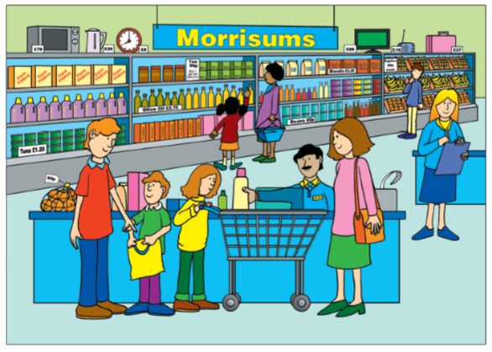
Notes:
Why do we use standard units? Why not non standard units?

Slide 3
Notes:
Why do we use standard units? Why not non standard units?

