Slide 1
Solving problems with rounding
Downloadable Resource
Mathematics
Miss Oreyomi

Slide 2
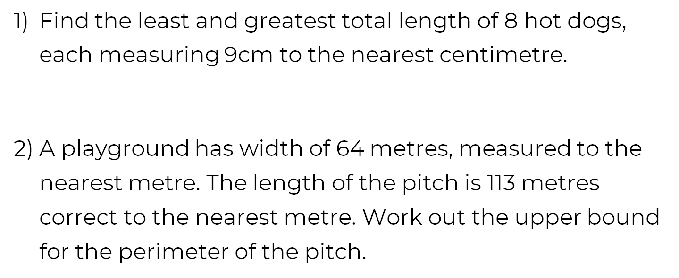
Questions

Slide 3
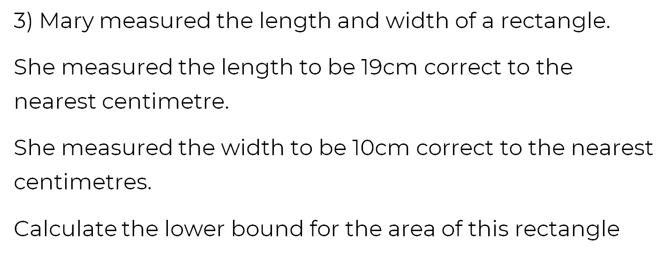
Questions

Slide 4
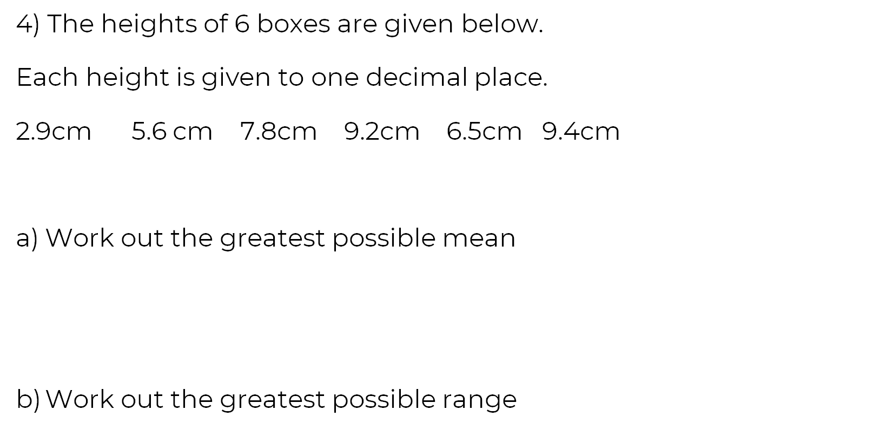
Questions

Slide 5
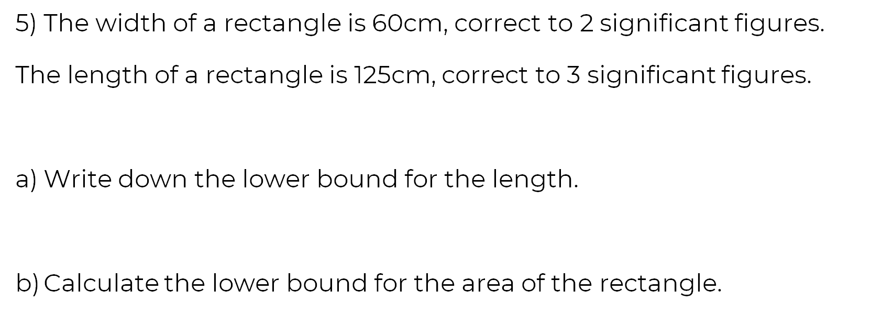
Questions

