Slide 1
Solving two-step equations
Maths
Miss Parnham

Slide 2
Solving two-step equations
104°
y
×4
+19
7
t°
t°

Slide 3
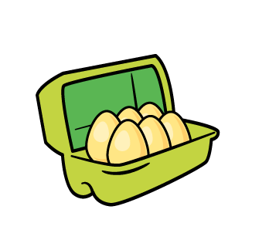
Solving two-step equations
7. A box of 6 eggs weighs a total of 329.6 g.
The box weighs 10.4 g.
Form and solve an equation to find the mean weight of one egg.
8. I have three cards.
Two of them have the same value.
Their total value is 3.3
What could the other two be worth?
p
p
p
p
0.7 m
?
?
-2.4
8.9 m

Slide 4
Answers

Slide 5
Solving two-step equations
q = 80
a = 2
b = -1
p = 7
r = 9
c = -8
d = -56
s = 15
104°
y
×4
+19
7
2t+104 = 180
t = 38
t°
t°
4y + 19 = 7
y = -3

Slide 6
Solving two-step equations
6e + 10.4 = 329.6
e = 53.2
7. A box of 6 eggs weighs a total of 329.6 g.
The box weighs 10.4 g.
Form and solve an equation to find the mean weight of one egg.
8. I have three cards.
Two of them have the same value.
Their total value is 3.3
What could the other 2 be worth?
w = 1.5
x = 5.9
53.2 g
y = -0.875
Both 2.85 or -2.4 and 8.1
?
?
-2.4
p
p
p
p
0.7 m
8.9 m
4p + 0.7 = 8.9
p = 2.05
2.05 m
2c + -2.4 = 3.3
c + -4.8 = 3.3
c = 2.85
c = 8.1

