Slide 1
Lesson 1 : Striking & Fielding Games
Cricket
Physical Development - Applying Learning
Alistair

Slide 2
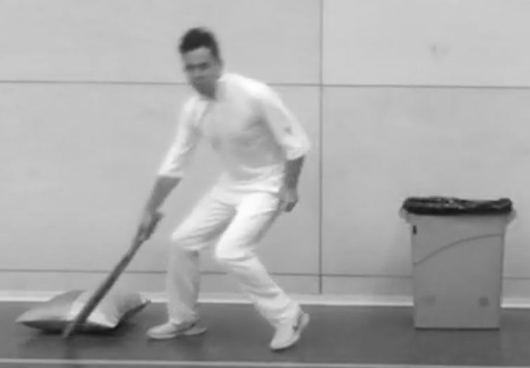
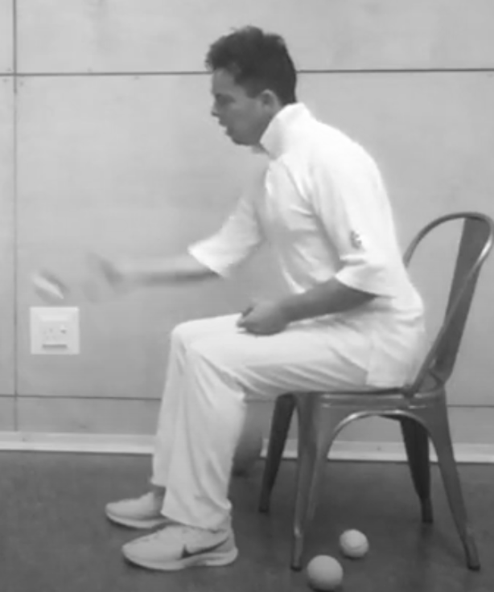
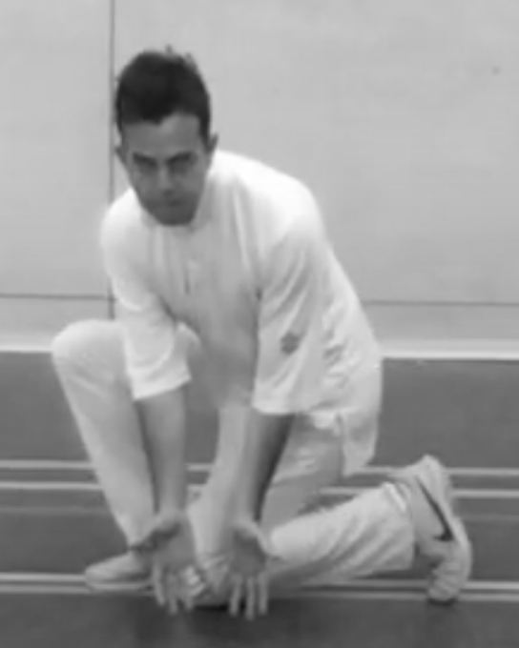
Activity Card
Striking & Fielding: Cricket
Use equipment safely and always be aware of people around you when batting.
Practise your batting skills, progressing from a large ball to a tennis / cricket ball.
Play a game of kwik cricket and see how many runs you can score.
Refine your skills and bowl at a target with increasing accuracy.
Work together as a team in a game of kwik cricket.
Show an awareness of changes in your body when you are exercising.
Bowl at a set target either from a seated or standing position.
Use the ‘long barrier’ to prevent the ball going past you.

