Slide 1
Unit 3 Multiplication and division
Short division
Mathematics
Miss Thomas

Slide 2
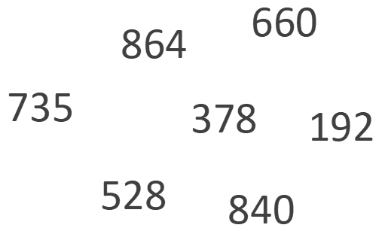
Question 1
Which numbers are multiples of exactly three of the numbers
below?
Can you find a number which is a multiple of at least five of the numbers?
What is the same? What is different?
What else do you notice?
Notes:
Model the Independent Task using the number 972. Pupils will be exploring whether 3-digit numbers are multiples of the specified 1- digit numbers. Take predictions as to which 972 will and will not be a multiple of. 972 is not a multiple of five because all multiples of five end in five or zero. I think 972 is a multiple of nine because 900 and 72 are both multiples of nine. I think 972 is a multiple of four because it is an even number.

Slide 3
Question 1 Answers
660 is divisible by 3,4,5,6
864 by 3,4,6,8,9
528 by 3,4,6,8;
192 by 3,4,6,8
378 by 3,6,7,9
840 by 3,4,5,6,7,8
735 by 3,5,7
Notes:
Here are the answers. For some of the equations, could you have used a different method, otehr than short multiplication?
Yes, some you may have partitioned the number and divided parts seperatley.

