Slide 1
Angles and Shape:
To revise angles
Main Independent Activity
Maths
Miss Brinkworth

Slide 2
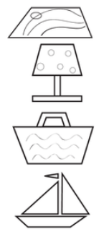
Part 1: Have a go at these questions
Which 2 objects below contain right angles?
2. Match the angle with the description
Right smaller than a right angle
Obtuse 1 quarter turn
Acute bigger than a right angle
Challenge -
Find 2 acute and 2 obtuse angles
Notes:
Remember

Slide 3
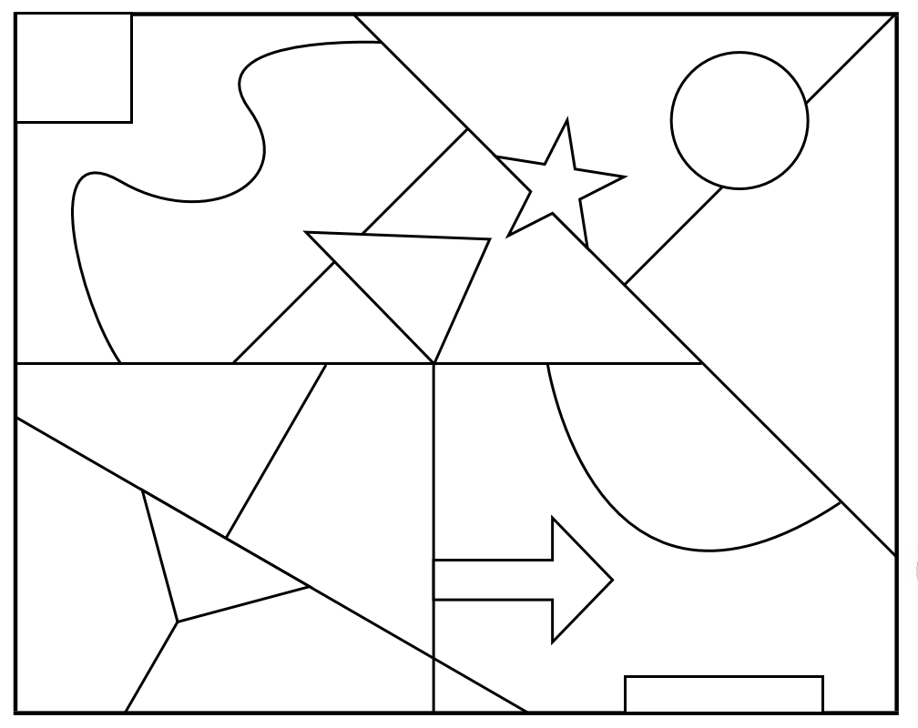
Part 2
What angles are
purple?
Which angles are
pink?
Which angles are
orange?
Challenge - find
another one of each
Notes:
Remember

