Slide 1
Lesson 3: In a While, Crocodile
Python Programming with Sequences of Data
Computing
Rebecca Franks
Materials from the Teach Computing Curriculum created by the National Centre for Computing Education

Slide 2
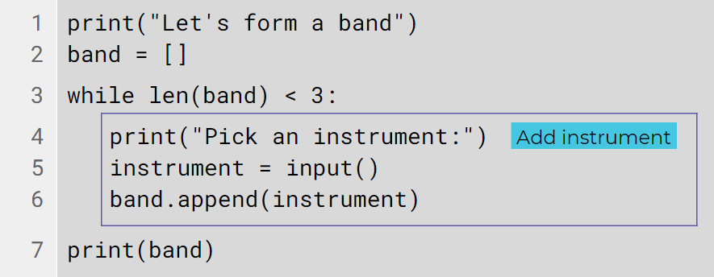
Worked Example .Form a band, version 1
This program repeatedly reads the names of musical instruments and adds them to a list. The program stops when the length of the list reaches three.

Slide 3
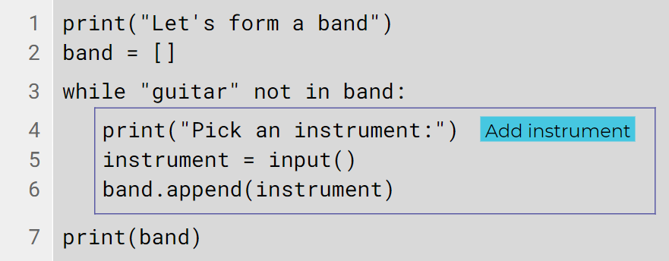
Worked Example .Form a band, version 2
This program repeatedly reads the names of musical instruments and adds them to a list. The program stops when a guitar is added to the list.

Slide 4
Task 1 .
You will develop a program that plans a European city-hopping trip, by randomly selecting cities out of a given list.
Step 1 - Open this program oaknat.uk/comp-py-hopping-1 in Repl.it
Line 1 imports the list of cities that the program will use. Note that this is not a standard Python component. The list has been created specifically to allow you to perform this activity.
The choice function (imported from the random module in line 2) is used to randomly select an item out of the list of cities (line 3).
1 2 3 4 | from ncce.data import cities from random import choice city = choice(cities) print(city)

Slide 5
Task 1 .
Step 2
Run the program at least three or four times to see how a different European city is selected every time.
Step 3
Remove the last line from your program. You won’t need it.
- | print(city)

Slide 6
Task 1 .
Step 4
Add the lines on the next slide into your program. They are provided in no particular order.
Rearrange these lines so that your program repeatedly selects a random city out of the cities list, and adds it to the trip list.
Your program should stop when the length of the trip list reaches five items.
At the end, the program should display the itinerary, i.e. the trip list.
Tip: You must indent the lines that will form the while-block and will be repeated.

Slide 7
Task 1 .
Remember that these lines are presented in no particular order. You will need to decide the order of the lines of code.
+ + + + + | print("City hopping random planner") print("Itinerary:", trip) trip = [] trip.append(city) while len(trip) < 5:

Slide 8
Task 1 .
Here is some example input and output for how this program is expected to run.
Example
Note: Use this example to check your program. The actual cities contained in the itinerary are randomly selected and will be different every time the program is executed.
The program displays an initial message. | City hopping random planner
After compiling a list of five random cities, the program displays the itinerary: | Itinerary: ['London', 'Stockholm', 'Moscow', 'Athens', 'Budapest']

Slide 9
Task 2 .No duplicates please
Extend the program so that every city selected is promptly removed from the list of cities. This way, no city can be selected twice for your trip.
Task 3 .Last stop: London
Modify the program so that the process of random city selection continues until London is selected and added to the trip.
Before displaying the itinerary, consider also inserting London at the beginning of the trip list, so that the trip appears to be circular.

Slide 10
Task .
You will start with an existing program that randomly picks a European capital out of a list and asks the user to guess it. You will extend the program so that it provides the user with hints.

Slide 11
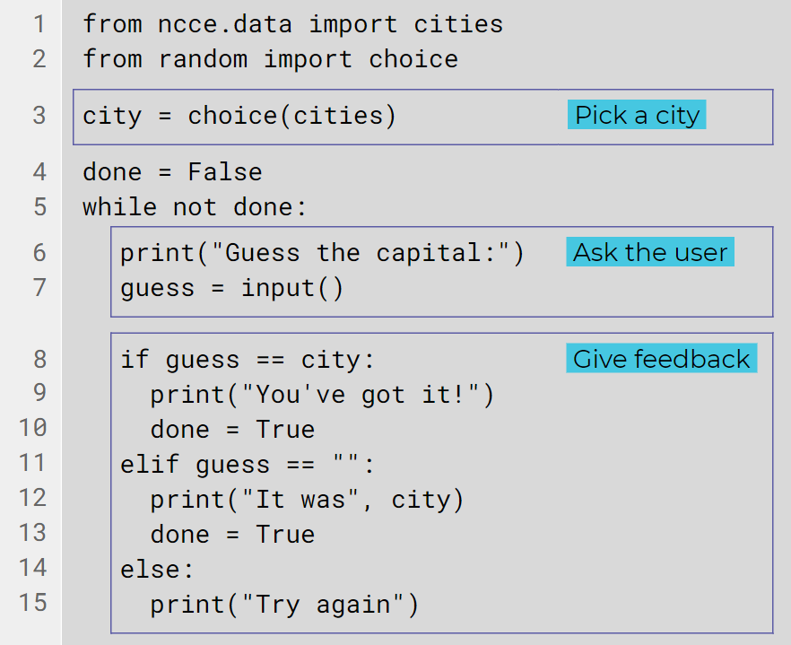
Task .
Step 1 - Open this program oaknat.uk/comp-py-cities-1 in Repl.it

Slide 12
Task .
Take a look at the program that you have just opened:
Line 1 imports the list of cities that the program will use. Note that this is not a standard Python component. The list has been created specifically to allow you to perform this activity.
The choice function (imported from the random module in line 2) is used to randomly select an item out of the list of cities (line 3).

Slide 13
Task .
Step 2
Run the program a couple of times to see how it currently works. You will find it is very hard for the user to guess the city, without any additional information.
Tip: Look at lines 11 to 13. While testing the program you can simply press Enter (without entering a city) and the city will be revealed, terminating the game.

Slide 14
Task .
Step 3 - Add the incomplete lines below to your program, right above the else-block.
Complete the gaps so that the program reveals the first letter of the city to the user, in the case where the city’s first letter is different from the first letter of the user’s guess.
Tip: You can access a specific character in a string just like you can access a specific item in a list, by using the string’s name followed by an index in square brackets.
Tip: You must indent these lines properly, as they are part of the while-block.
+ + | elif : print("The first letter is", ) else: print("Try again")

Slide 15
Task .
Here is some example input and output to show how the program should run.
Example
Note: This example illustrates how your program should work. The output of your program will depend on the randomly selected city and the user’s input, so it will be different each time you execute it.
The program displays a prompt and waits for keyboard input. | Guess my European capital:
The user types a reply. | Prague
The program displays a hint. The selected city is actually Moscow (different first letter). | The first letter is M

Slide 16
Task .
Step 4
Add the incomplete lines below to your program, right above the else-block.
Complete the gaps so that the program reveals the length (number of characters) in city to the user, in the case where city’s length is different from the length of the user’s guess.
Tip: Use the len function to retrieve the number of characters in city and guess.
Tip: You must indent these lines properly, as they are part of the while-block.
+ + | elif : print("It has", , "letters") else: print("Try again")

Slide 17
Task .
Here is some example input and output to show you how your program should run:
Example
Note: This example illustrates how your program should work. The output of your program will depend on the randomly selected city and the user’s input, so it will be different each time you execute it.
The program displays a prompt and waits for keyboard input. | Guess my European capital:
The user types a reply. | Prague
The program displays a hint. The selected city is actually Paris (same first letter but different length). | It has 5 letters

Slide 18
Task .
Step 5 - Add the incomplete lines below to your program, right above the else-block.
Complete the gaps so that the program reveals the second letter of city to the user, in the case where city’s second letter is not contained in the user’s guess.
Tip: Use the in operator to check if a character is contained in a string.
Tip: You must indent these lines properly, as they are part of the while-block.
+ + | elif : print("It contains letter", ) else: print("Try again")

Slide 19
Task .
Here is some example input and output so that you can see how your program should run:
Example
Note: This example illustrates how your program should work. The output of your program will depend on the randomly selected city and the user’s input, so it will be different each time you execute it.
The program displays a prompt and waits for keyboard input. | Guess my European capital:
The user types a reply. | London
The program displays a hint. The selected city is actually Lisbon (same first letter, same length, but second letter of city is not contained in guess). | It contains letter i

Slide 20
Explorer Task .(Optional)
Extend the program so that it counts the number of attempts the user makes and displays them after the game is over.

