Slide 1
Combined science - Physics - Key stage 4
Particle Models - worksheets
Mr Charman
Mr Charman

Slide 2
Energy transfers - Downloadable worksheet
In lesson questions
Exam questions

Slide 3
Independent practice
Copy and complete the table. Use the words below to help you fill in the gaps.
particles; touching; ordered rows; random; rows; vibrate; strong; weak; attractive forces
State | Solid | Liquid | Gas
Diagram
Arrangement
Movement
Attraction between particles

Slide 4
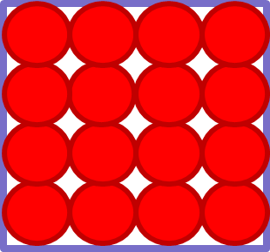
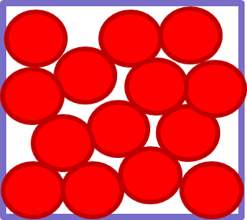
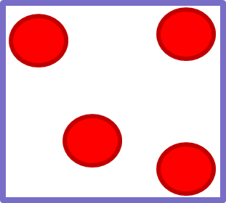
Review
State | Solid | Liquid | Gas
Diagram
Arrangement | Ordered structure in rows, all particles touching | Random structure, all particles touching | Random structure, particles not touching
Movement | Fixed positions, can vibrate | Can move freely over each other | Fast moving, random
Attraction between particles | Very strong forces of attraction | Weaker forces of attraction | weakest forces of attraction

Slide 5
Independent practice
Solids:
have a fixed shape
Difficult to compress
Gases
Will spread and fill the entire container
Easy to compress
Use your knowledge to explain the above properties. You should consider:
The spacing between the particles
The movement of individual particles
The forces between particles

Slide 6
Review
Solids:
have a fixed shape
Strong forces of attraction mean particles are not free to moves around so shape is fixed.
Difficult to compress
Particles have no gaps between one another r so there is no room for particles to move closer.

Slide 7
Review
Gases
Will spread and fill the entire container
Very weak intermolecular forces of attraction so particles move randomly and spread out.
Easy to compress
Particles are far apart, so there is space for the particles to move closer

Slide 8
Exam questions
A question from Exampro
Q1
Solid, liquid and gas are three different states of matter.
Describe the difference between the solid and gas states, in terms of the arrangement and movement of their particles.

Slide 9
Exam questions
A question from Exampro
Q2
The figure below shows a simple model of the three states of matter.
A student explains density to his teacher using the particle model in the figure above.
His teacher says there are limitations to the model.
Give two limitations of the particle model in the figure above.

Slide 10
Exam questions - Review
A question from Exampro
Q1
solid
particles vibrate about fixed positions (1)
closely packed (1)
accept regular
gas
particles move randomly (1)
accept particles move faster
accept freely for randomly
far apart (1)
1

Slide 11
Exam questions - Review
A question from Exampro
Q2
Any two from:
• no forces shown between spheres
• atoms / molecules / ions are not solid spheres
• not all the same size.
2

