Slide 1
Sequences The n^{th} term rule: position-to-term for arithmetic sequences
Downloadable Resource
Mathematics
Ms Jones

Slide 2
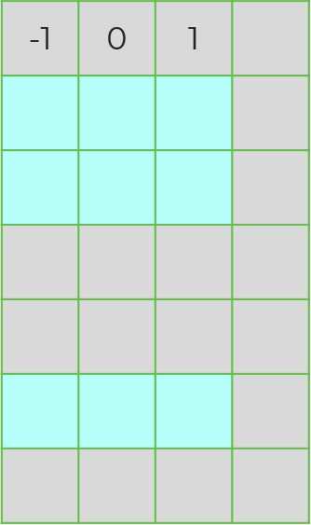
Try This
Some columns and rows have been torn off this number grid.
Imagine this grid had 6 columns.
What numbers would go in the blue squares?
How would this change if the grid had 8 columns? What about 100 columns?
Row 1
Row 2
Row 3
Row 100

Slide 3
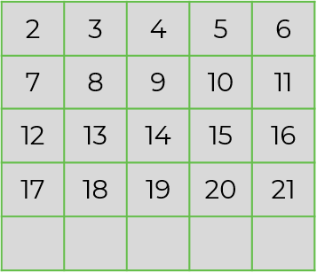
Independent task
A
B
C
D
E
Row 1
Which column in the grid to the right has
the following position-to-term rules:
a) 5n b) 5n – 3 c) 5n + 1
Work out the position-to term-rules for columns a, b, c, and d from the 2 grids below.
Work out position-to-term rules for the following sequences:
a) 1, 3, 5, 7, 9, … b) 2, 8, 14, 20, 26, … c) -5, -1, 3, 7, 11, …
Row 2
Row 3
Row 4
44
a
b
c
d
3 | 4 | 5 | 6
7 | 8 | 9 | 10
-12 | -11 | -10 | -9 | -8 | -7 | -6
-5 | -4 | -3 | -2 | -1 | 0 | 1
44
44

Slide 4
Explore
Look at the descriptions of three arithmetic sequences.
How many n^{th} term rules can you think of to match each description?
Can you find any n^{th} term rules that would work for all three descriptions?
Some of the terms in my sequence are prime numbers.
The first term of the sequence lies between 0 and -5.
There are four terms between 0 and 30.

