Slide 1
German
Shopping for clothes and souvenirs [3 / 3]
further practice of adjective endings
problems with items
revisiting the perfect tense
Herr Scales

Slide 2
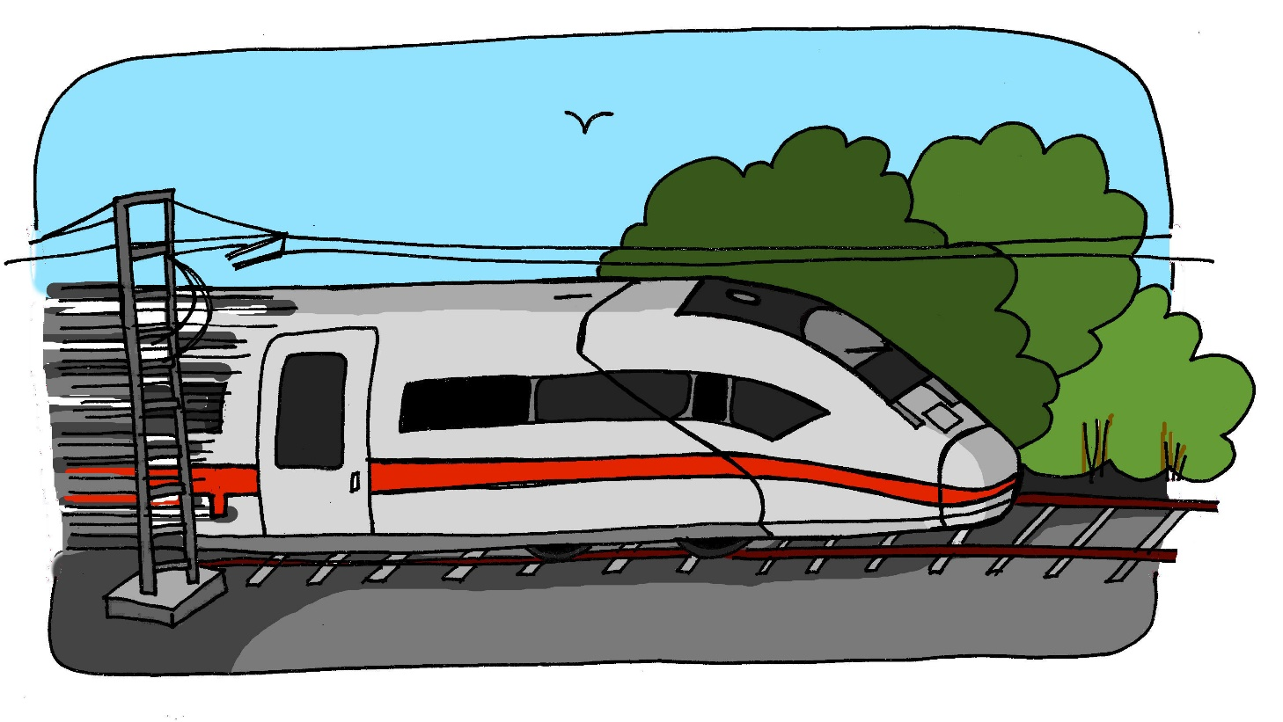
z
Zug

Slide 3
S
Sollen

Slide 4
zurück
zahlen
Zeit
back
to pay
time
super
Saal
seit
great
large room
since

Slide 5
(an)probieren | to try on
(um)tauschen | to exchange(goods)
passen | to suit/fit
(zurück)bringen | to bring (back)
kaputt | broken
preiswert/billig | good value/cheap
teuer | expensive
das (Sonder)angebot | special offer
die Ermäßigung | reduction
das Bargeld | cash

Slide 6
Revisiting the perfect tense
In German, past participles of weak verbs are usually formed by taking the en off the infinitive and adding a ge to the front and a t to the end
Infinitive
Past participle
Perfect tense example
Translation
kaufen
gekauft
ich habe gekauft
I (have)bought
(um)tauschen
(um)getauscht
ich habe (um)getauscht)
I (have) exchanged
passen
gepasst
es hat mir gepasst
it (has) suited me

Slide 7
Revisiting the perfect tense - weak verbs
In German, past participles of verbs ending in -ieren are formed by taking the en off the infinitive and adding a t to the end. There is no ge added to the front.
Infinitive
Past participle
Perfect tense example
Translation
reparieren
repariert
ich habe repariert
I (have) repaired
funktionieren
funktioniert
es hat funktioniert
it (has) worked
probieren
probiert
ich habe es probiert
I have tried it
Of course, there are also strong verbs which have irregular past participles. These have to be learnt by heart! Eg. bringen - gebracht (to bring - brought), gehen -gegangen (to go - gone) denken- gedacht (to think - thought)

Slide 8
Can you form past participles from these infinitives?
Infinitive | Past participle
machen- to do
gemacht -done
sagen - to say
gesagt - said
lachen - to laugh
gelacht - laughed
zahlen - to pay
gezahlt - paid

Slide 9
Can you form past participles from these infinitives?
Infinitive | Past participle
probieren- to try
probiert -tried
funktionieren - to function
funktioniert - functioned
reparieren - to repair
repariert - repaired
aktivieren - to activate
aktiviert - activated

Slide 10
And a few strong verbs to test your memory! All irregular so have to be learnt by heart...
Infinitive | Past participle
gehen- to go
gegangen -gone
fahren - to travel
gefahren - travelled
bringen - to bring
gebracht - bought
denken - to think
gedacht - thought

Slide 11
Summary of learning
In German, past participles of weak verbs are usually formed by taking
the ___ from the infinitive. You then add a _____to the beginning and a ______to the end.
Eg kaufen - _____________
Past participles of verbs ending in -ieren, you take the ___from the infinitive but do NOT add ____to the front. You do, however, add ____to the end.
Eg. probieren - ________________
Past participles of strong verbs have to be learnt___________________
en
ge
t
gekauft
en
ge
en
probiert
by heart

