Slide 1
Bearings on polar grids
Downloadable Resource
Mathematics
Mr Coward

Slide 2
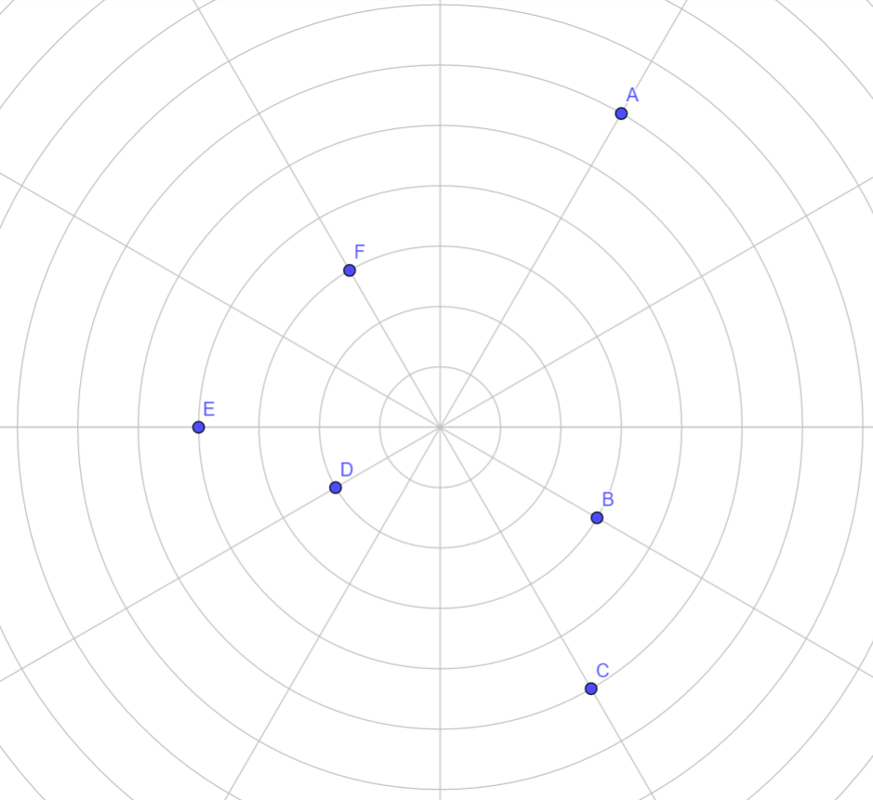
Try this
Read Cala’s statement. Can you make similar statements about the other points?
A
N
F
E
D
O
B
C
The space between each circle is 1cm

Slide 3
Connect
What are the bearings of A and B?
Could you add two more points to form a rectangle?
What are the bearings of these new points?
A
N
B

Slide 4
What calculation does not find the size of the angle between lines?
Option 1
Option 2
Option 3
Option 3

Slide 5
Independent task
N
A
N
B
Find the bearing of A, B, C, D, and E from 0. What do you notice?
Draw a bearing of 60° of the three diagrams where it is easiest.
N
N
N
C
D
E

Slide 6
Independent task
N
A
N
B
Find the bearing of A, B, C, D, and E from 0. What do you notice?
Draw a bearing of 60° of the three diagrams where it is easiest.
Bearing of 015°
Bearing of 022.5°
N
N
N
C
D
D
Bearing of 30°
Bearing of 45°
Bearing of 60°

Slide 7
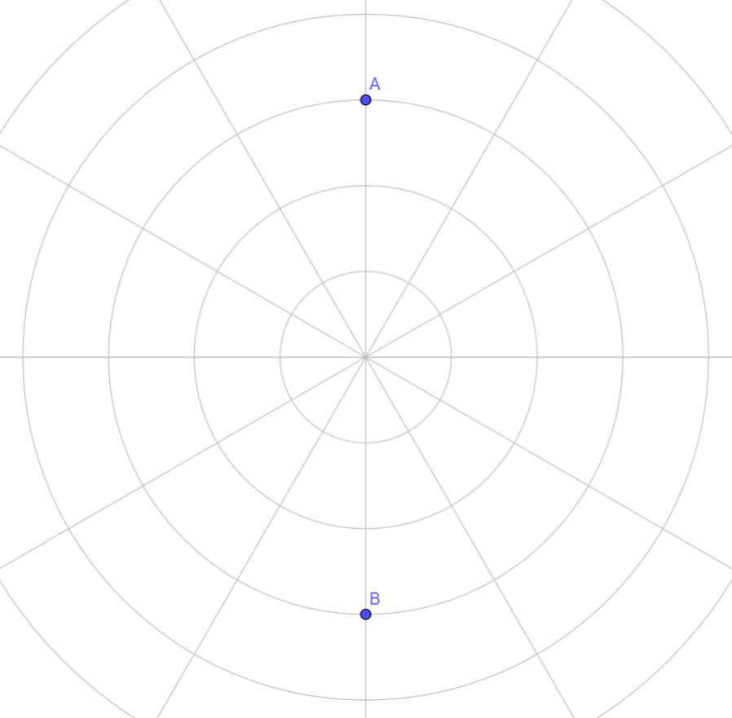
Explore
Describe the position of two more points that form the vertices of the following quadrilaterals:
Kite
Square
Rhombus
Rectangle
Isosceles trapezium
A
N
B

Slide 8
Pause the video to complete your task
Resume once you’re finished

Slide 9
Explore - hints
Kite
Square
Two pairs of equal sides.
Diagonals meet at a right angle
Four equal sides.
Diagonals meet at a right angle
Diagonals are equal length
Rhombus
Isosceles trapezium
Four equal sides.
Diagonals meet at a right angle
Diagonals not equal length
Non-parallel length are equal.
Diagonals do not meet at a right angle

Slide 10
Explore - hints
N

Slide 11
Explore - hints
N
N

Slide 12
Explore - hints
N
N

Slide 13
Answers
N

Slide 14
Answers
N
N

Slide 15
Answers
N
N

Slide 16
Share your work with Oak National
If you'd like to, please ask your parent or carer to share your work on Twitter tagging @OakNational and #LearnwithOak

