Slide 1
Money
Exploring different combinations of coins for a given total of up to 10p
Mathematics Independent Task
Mrs Khaira

Slide 2
Activity 1

Slide 3
Activity 1

Slide 4
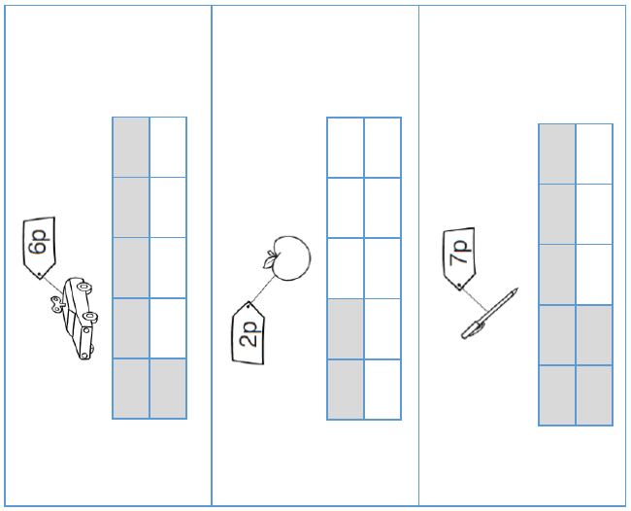
Activity 2

Slide 5
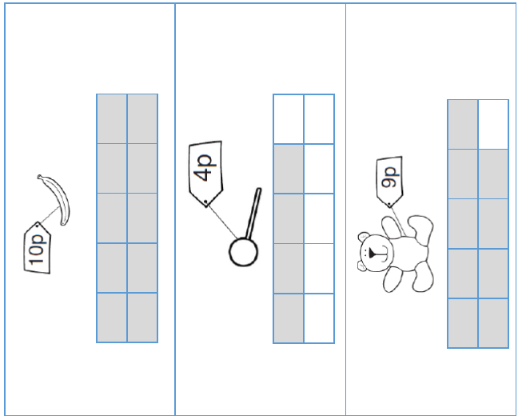
Activity 2

