Slide 1
Mathematics
Add and subtract fractions with the same denominator
Mr Southall

Slide 2
Revision: fractions
What fractions are shown here?
Which is the odd one out? Why?
Can you think of any other examples of fractions?

Slide 3
New learning: adding fractions

Slide 4
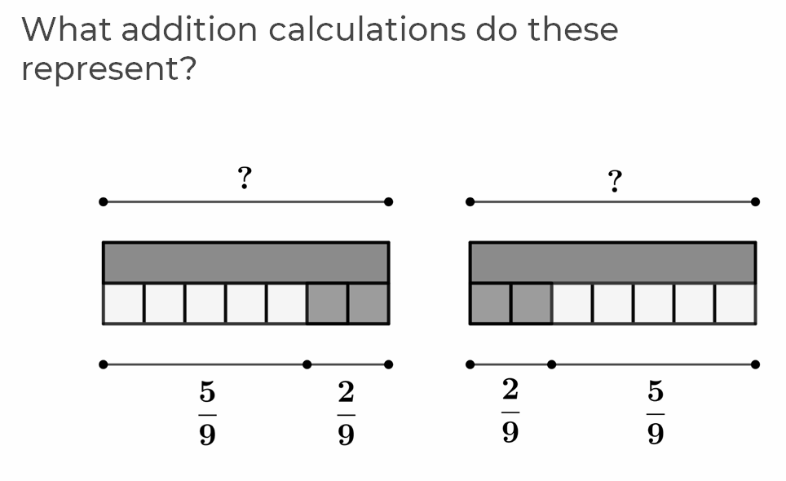
New learning: adding fractions

Slide 5
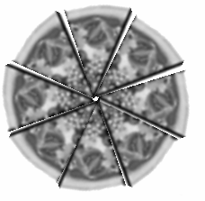
Develop learning:
A pizza has eight slices.
Bella eats three slices and Lara eats two slices.
What fraction of the pizza has been eaten?
What fraction is left?

Slide 6
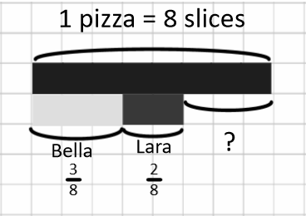
Develop learning:
A pizza has eight slices.
Bella eats three slices and Lara eats two slices.
What fraction of the pizza has been eaten?
What fraction is left?

Slide 7
Develop learning: crossing 1
Bella eats 5 slices, Lara eats 7 slices.
How much pizza have they eaten in total? How much is left?
Number line
Bar model
Fraction

Slide 8
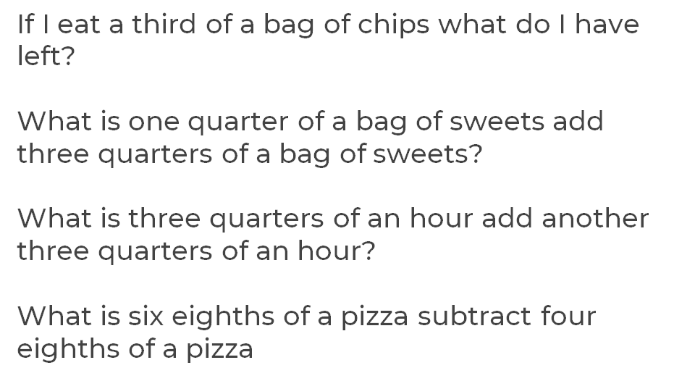
Develop learning: crossing 2

Slide 9
Develop learning: crossing 3

Slide 10
Independent task:
What calculations can you show using these?
Can you find a calculation showing:
a fraction above 1?
add three fractions with an answer less than one?
a fraction equivalent to a half?
two fractions with a difference of three eights?
a calculation with an answer above two?

